Slide 1
Deploying SQL Server Databases with Octopus Deploy
in 1 day, for 1 dollar

Slide 2
Welcome
Let’s be wonderful to each other.
Notes:
Everyone is welcome here. This is a safe place where we are wonderful to each other.
Disable private chats between attendees, if possible.
Provide guidance regarding webcams.
Anti harassment policy / code of conduct etc.

Slide 3
Why we are here
Welcome
Automated deployments are simultaneously:
Faster
Safer
Cheaper
Active learning beats passive learning:
Build your own PoC
Keep your own personal reference project
Notes:
Why are we here?
We understand that automated deployments enable a virtuous cycle of speed and safety, that’s fundamentally better suited to releasing working software, on time, and under budget.
In order to develop the knowledge and skills to practice automated deployments, we are going to embrace active learning. We aren’t just going to talk, we are going to get our hands dirty. And when we are done, you’ll have your own template solution that you can spin up and tear down whenever you like. You’ll leave today with a reference project in your back pocket, which you can use as a template as you roll our these tools within your own organisations.

Slide 4
Introductions
Welcome
Your Trainer: <INSERT TRAINER NAME>
You:
<TRAINERS ROLE>
<TRAINERS TAGLINE>
<TRAINERS EXPERIENCE>
<TRAINERS FLAIR>
Why did you choose to attend today’s class?
Do you have prior experience with DevOps?
Have you used GitHub, AWS or Octopus Deploy before?
What’s your personal goal for today?
PLACEHOLDER SLIDE (Update before class)
Notes:
But before we get started, it’s high time we got to know about each other.
My name is Trainer Mc TrainerFace and I’m qualified to lead this class because…
What would really help me is if you could each tell me a little bit about yourselves and why you are attending this class today. Most importantly I’d like to know if you have any specific goals for the day and how much experience you have with Octopus, GitHub, .NET Core and AWS. It will help me to explain the content at the right level if I have a basic idea about your existing knowledge/experience. I don’t want to patronize you if you’ve all got extensive Git experience, but I also don’t want to leave anyone behind, so we will be going at the pace of the least experienced attendees. It’s important that everyone feels comfortable to learn at their own pace.
In case you are struggling for ideas about how to introduce yourself, I’ve suggested a few things to think about on this slide, but nothing is essential.
[Introductions can be conducted however is appropriate for the training style. For a small on-site or videoconference group it might be nice to let attendees speak to introduce themselves. For larger groups it might be easier to open a chat window and ask people to write a couple of words so you can scan through the answers more quickly. For very large groups consider creating some sort of poll that attendees can click so that you can guage the sorts of attendees. Are they ops/dev folks? Are they experienced with git or not? Are they more concerned with speed, safety, quality, efficiency, teamwork etc?]

Slide 5
Today’s learning objective
Welcome
Attendees will understand, and have practical experience using, the core Octopus features and additional tools/services required to automate database deployments, including:
Environments, Deployment Targets, Tentacles and Workers
Operations Runbooks, Deployments, Variables and Releases
Various open-source and 3rd party database deployment tooling options
Attendees will have an awareness of more advanced Octopus features, and an opportunity to discuss unique requirements with an experienced trainer.
Additionally, attendees will learn the bare minimum GitHub and AWS skills required to implement a SQL Server deployment pipeline.
Notes:
You are going to build and deploy your own website to the public internet – end to end.
If you don’t have any experience with GitHub, AWS

Slide 6
Today’s task
Welcome
Build your own working PoC by the end of the day.
You’ll deploy a
SQL Server Database (from…)
GitHub (onto…)
Windows Servers (hosted in…)
Amazon Web Services (AWS)
(Other tech/platforms are available)
Notes:
You are going to build and deploy your own website to the public internet – end to end.
If you don’t have any experience with GitHub, AWS

Slide 7
Octopus Deploy (General marketing)
Welcome
Some
Intro
To
Octopus
TO DO!
(Check if Octopus marketing team already have a standard slide for this)
Notes:
First, let’s introduce Octopus. You might know a little or a lot about us already, but here’s an overview of what we are about, why we exist, and what we do.

Slide 8
Octopus Deploy (vs Competition / Octo USP)
Welcome
Octopus Deploy’s killer USP
Why use Octopus instead of a competitor?
TO DO!
(Check if Octopus marketing team already have a standard slide for this)
Notes:
First, let’s introduce Octopus. You might know a little or a lot about us already, but here’s an overview of what we are about, why we exist, and what we do.

Slide 9
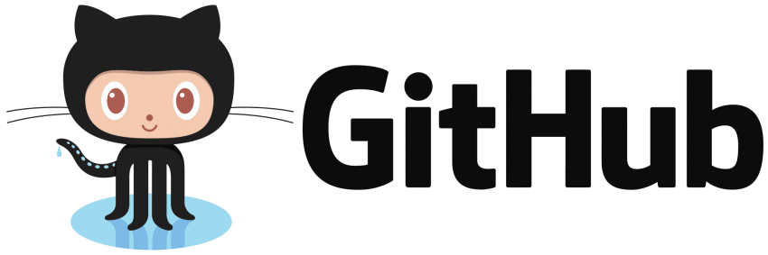
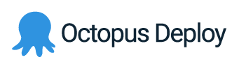
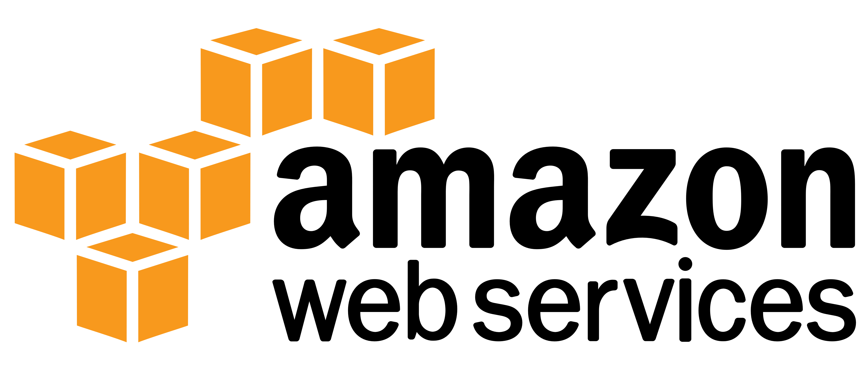
LAB 0: Prerequisites
Welcome
TO DO! Add link to page for other class
Attendees have either:
a basic awareness of core Octopus Deploy concepts, including Environments, Projects, Variables, Tentacles and Releases
attended the first training class in this series: Zero to Octopus Deploy PoC
Notes:
All attendees should have been provided with the lab manual in advance and you should have been informed that you need to set up accounts with GitHub, AWS and Octopus Deploy in advance. If you already have these accounts, great. If not, you should create these accounts now while I go through a few intro slides.
Start with your GitHub and Octopus Deploy accounts. You can leave the AWS account until the first break if you want.

Slide 10
Agenda
PART 1 – INTROS
09:00 - Welcome
09:30 - A brief intro to DevOps
10:00 - Forking the repo
PART 3 – DEPLOYING DATABASES
13:00 - Database DevOps
13:30 - Exploring the tooling options
14:00 - Configuring an SSDT project
10:30 Morning break
PART 2 – DEPLOYING INFRASTUCTURE
11:00 - Using Octopus Runbooks to
manage infrastructure
12:00 Lunch
14:45 Afternoon Break
PART 4 – EXTENSIONS
15:15 - Redgate, DbUp, Entity Framework
16:30 - Q+A
17:00 End of day
Notes:
Now we’re all acquainted, let’s explore the agenda for the day.
Briefly talk through the agenda.
Key points:
Break times: Do these work for everyone?
Prerequisites: You should have completed the prerequisites and lab 1 in advance. But don’t worry if you haven’t. There aren’t any new labs before the 1st break. If anyone still need to create their accounts or complete lab 1 please do so during the 1st break. Also if anyone had any issues please send me a message and we can pick it up in the break.
We’ll start with a basic DevOps 101 crash course. Before we write any code, let’s make sure we understand why we are doing this at all and why it’s important/valuable.
Part 2 is all about the infrastructure. Deploying our infrastructure and using Source Control, PowerShell and Octopus Runbooks to automate and audit our SQL Server installations.
Part 3 is mainly theoretical. I’ll talk about the various different approaches to database source control and deployment and I’ll provide an overview of the most popular tools.
In part 4 we’ll create our first database deployment pipeline using SSDT, since it’s the most popular tool for SQL Server.
Finally, in part 5, we’ll look at some alternate database deployment pipelines and you’ll have the opportunity to try out whichever tools you are most intrigued by.
We’ll aim to finish our PoCs by 4.30 to allow us 30 minutes for general Q+A and conversation, before finishing at 5pm. However, if we don’t finish on time you own all the code, infra and training materials so you can continue to build and extend your PoC in your own time at your own convenience and we’ll be happy to help over email etc for the next week to ensure you complete your PoC.

Slide 11

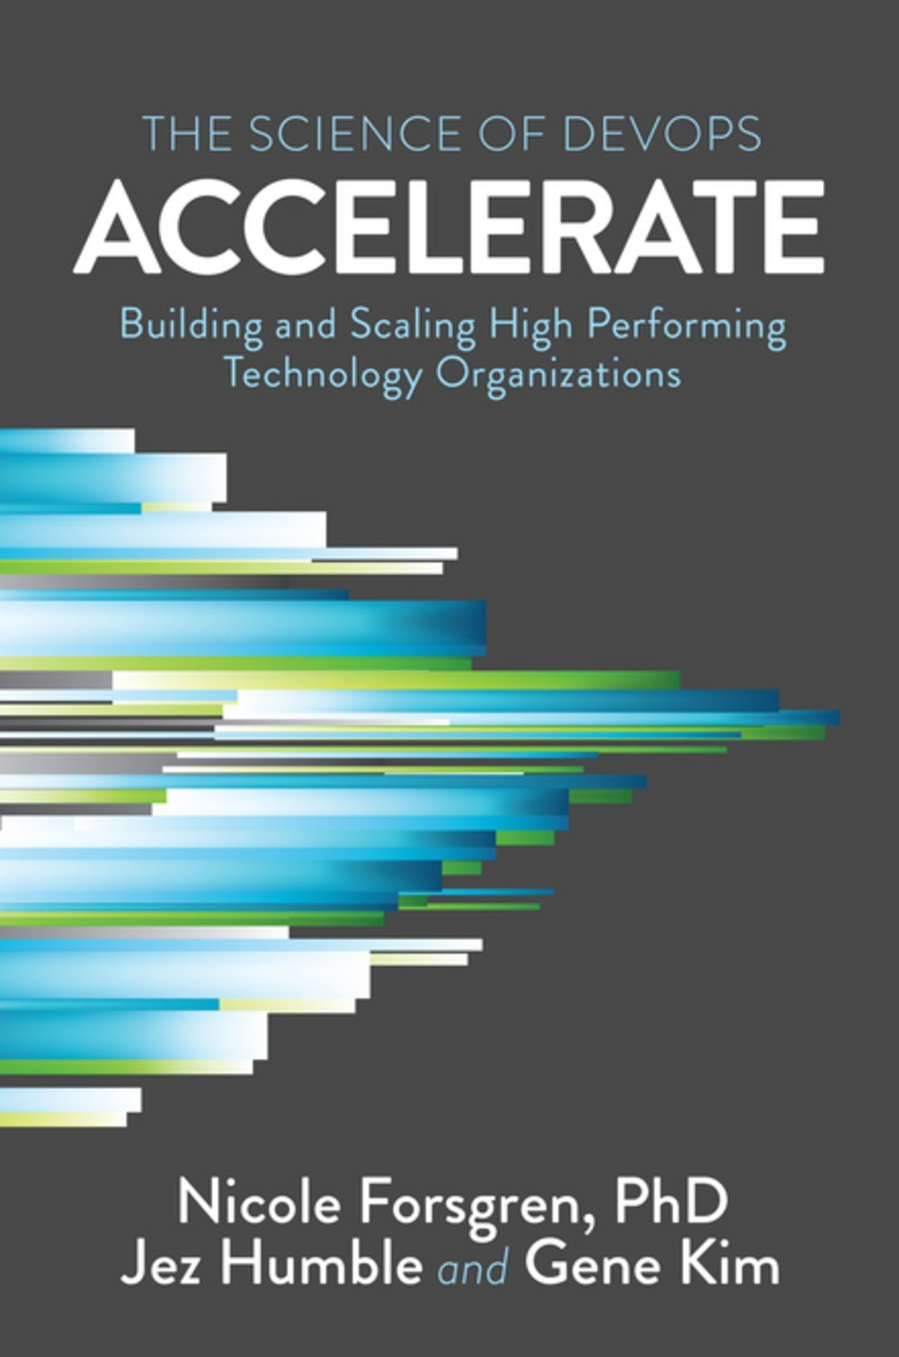
Accelerate: The Science of DevOps
A brief intro to DevOps
Nicole Forsgren
Accelerate
Notes:
You are logical, data folks - so let’s start with Accelerate, in which Nicole Forsgren articulately and persuasively demonstrates that DevOps isn’t just hype, it is predictive of positive business outcomes.
This is a scientific, data-driven study of the data gathered by the 2014-2017 State of Devops reports.

Slide 12
Accelerate: 4 key metrics
A brief intro to DevOps
Deployment Frequency
Lead Time
Mean Time to Restore
Change Failure %
Nicole Forsgren
Accelerate
Notes:
Forsgren groups respondents as low, medium and high performers with respect to these metrics. Why these metrics?

Slide 13
Accelerate: 4 key metrics
A brief intro to DevOps
“Analysis over several years shows that high-performing organizations were consistently twice as likely to exceed [the profitability, market share and productivity of] low performers.”
Nicole Forsgren
Accelerate
Notes:
These metrics are predictive of positive business outomes

Slide 14
Accelerate: 4 key metrics
A brief intro to DevOps
Deployment Frequency
Lead Time
Mean Time to Restore
Change Failure %
Nicole Forsgren
Accelerate
Notes:
Let’s take a more thorough look at these metrics. What do they mean?
[Talk through them one by one, and clarify exactly what they mean. 1 and 4 are both pretty straight forward, but 2 is a bit of a loaded term that might require more explanation. 3 is an opportunity to talk briefly about MTTR vs MTBF.]

Slide 15
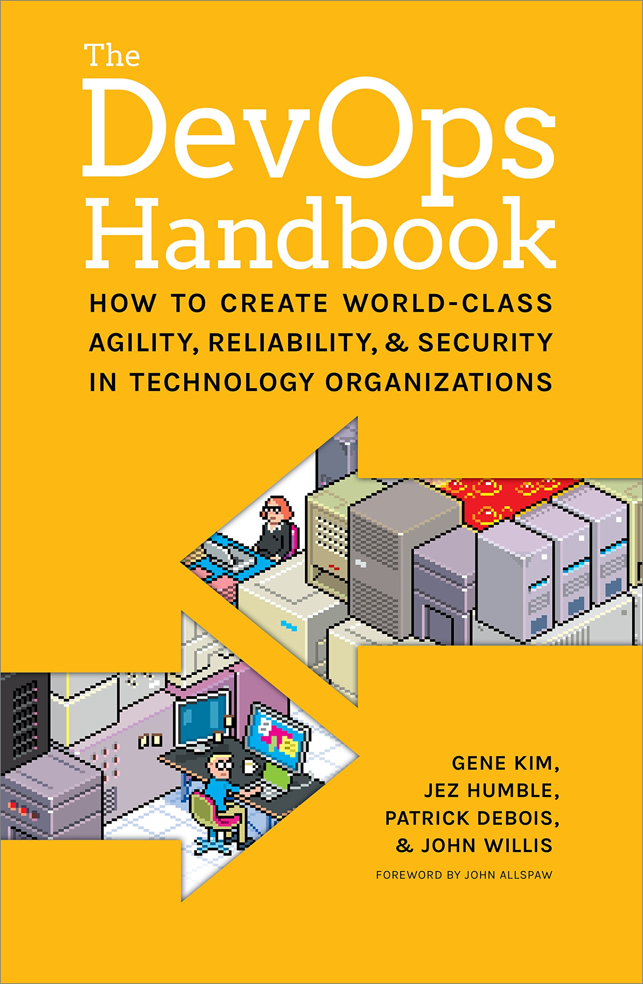
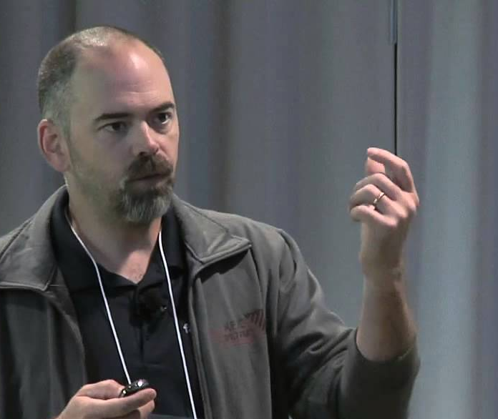
Small batch sizes
A brief intro to DevOps
“If we want more changes, we need more deployments.”
Chuck Rossi
Facebook
Notes:
Why are these 4 metrics so predictive of high performance and positive biz outcomes? Let’s take a real world example.
As Chuck Rossi put it, once any deployment grew above a certain size, it would predictably fail and cause significant harm. Hence, if your biz wants to move faster, you need more deployments, not bigger deployments.

Slide 16
Accelerate: 4 key metrics
A brief intro to DevOps
Deployment Frequency
Lead Time
Mean Time to Restore
Change Failure %
(Small batch sizes FTW!)
Nicole Forsgren
Accelerate
Notes:
These metrics basically enforce that concept. They force you to think about smaller batch sizes, safer deployments and shorter lead times.

Slide 17
24 capabilities to drive improvement
A brief intro to DevOps
Version control
Deployment automation
Continuous integration
Trunk-based development
Test automation
Test data management
Shift left on security
Continuous delivery
Loosely coupled architecture
Architect for empowered teams
Seek out customer feedback
Visualise work through stream
Work in small batches
Foster team experimentation
Lightweight change approvals
Monitor across app and infra
Check system health proactively
Implement WIP limits
Visualise work and quality
Generative culture
Support learning
Collaboration across teams
Make work meaningful
Transformational leadership
Notes:
Forsgren goes on to detail 24 technical practices that contribute toward progress against the 4 key metrics.
The first two are directly relevant to this class… although there’s a lot more to do.
I’m not going to talk through each of these practices, we don’t have time. However, we’ve included this slide to demonstrate:
Firstly: that version control and deployment is just the tip of the iceberg, and…
Secondly to direct you to further resources to where you can learn more.
So why are we just focussing on the top two capabilities for now? Let me explain…

Slide 18
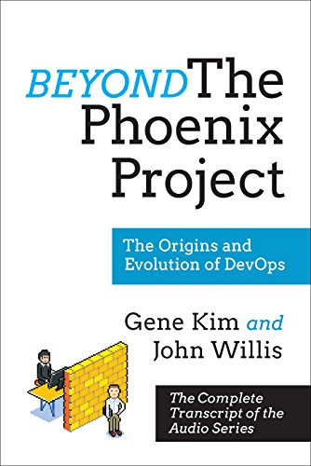

The Five Ideals
A brief intro to DevOps
“What I find so amazing, is that as an organization goes from a code deployment lead times that are measured in months, maybe even in quarters, down to minutes, the constraint moves in some pretty predictable ways.”
Gene Kim
Beyond the Phoenix Project
Notes:
As Gene Kim says, as people adopt DevOps practices, their productivity bottleneck moves in some pretty predictable ways.

Slide 19
The Five Ideals
A brief intro to DevOps
Environment creation
Code deployment
Testing
Architecture
Ideas
Gene Kim
Beyond the Phoenix Project
Notes:
The first issue people run into tends to be environment creation.
The second issue is typically code deployment.
Of course, no two orgs are the same, and it’s possible that for you it will be different – so you should certainly take this with a pinch of salt. It’s almost certainly worth your time to do a little analysis of you value streams, probably including some value stream mapping, just to double check. That’s a relatively inexpensive exercise, and it’s worth knowing your changes are likely to be effective before investing in a specific, targeted improvement.
That said, for most orgs, environment creation and code deployment are a pretty good place to start.
We’ll be covering both, in detail, in todays class, with a specific focus on SQL Server databases.

Slide 20
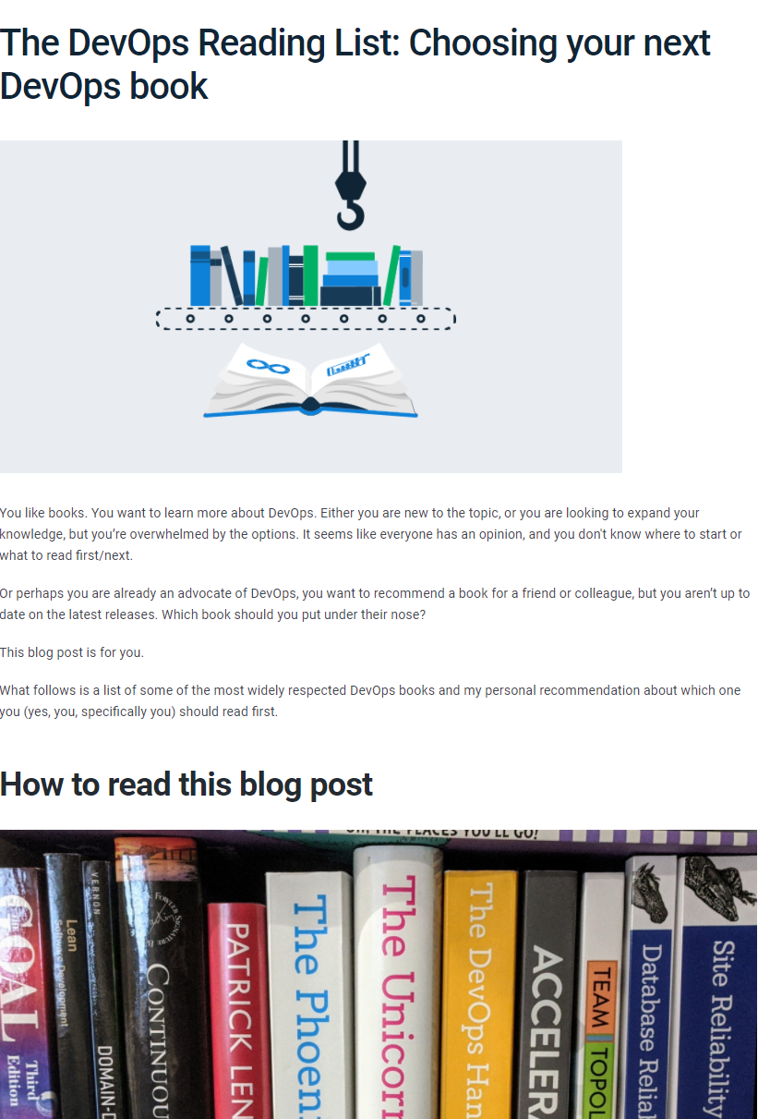
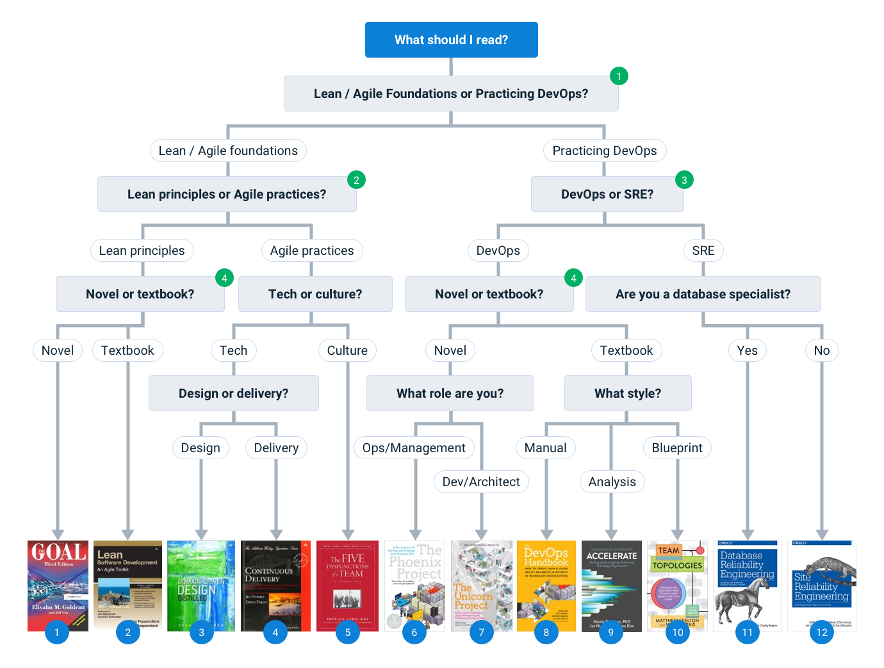
Further DevOps Reading…
A brief intro to DevOps
octopus.com/blog/devops-reading-list
Notes:
That’s all the DevOps theory we are going to cover today, but if you’d like to read more about the topic, Alex Yates has reviewed twelve of the most popular DevOps books for the Octopus blog. And he includes a simple decision tree to help you to choose one or two that should be a good fit for you.

Slide 21
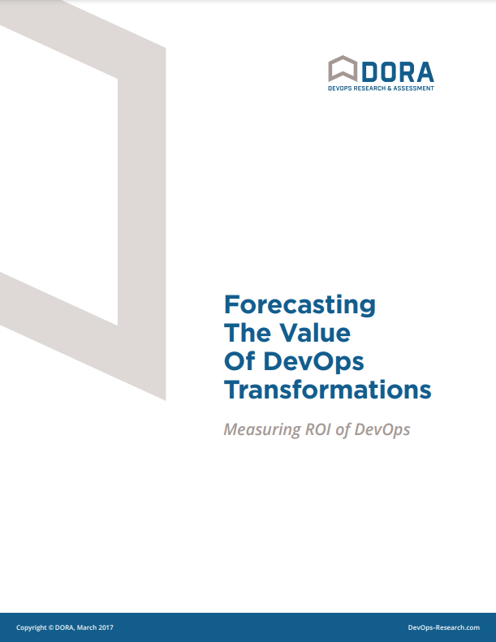
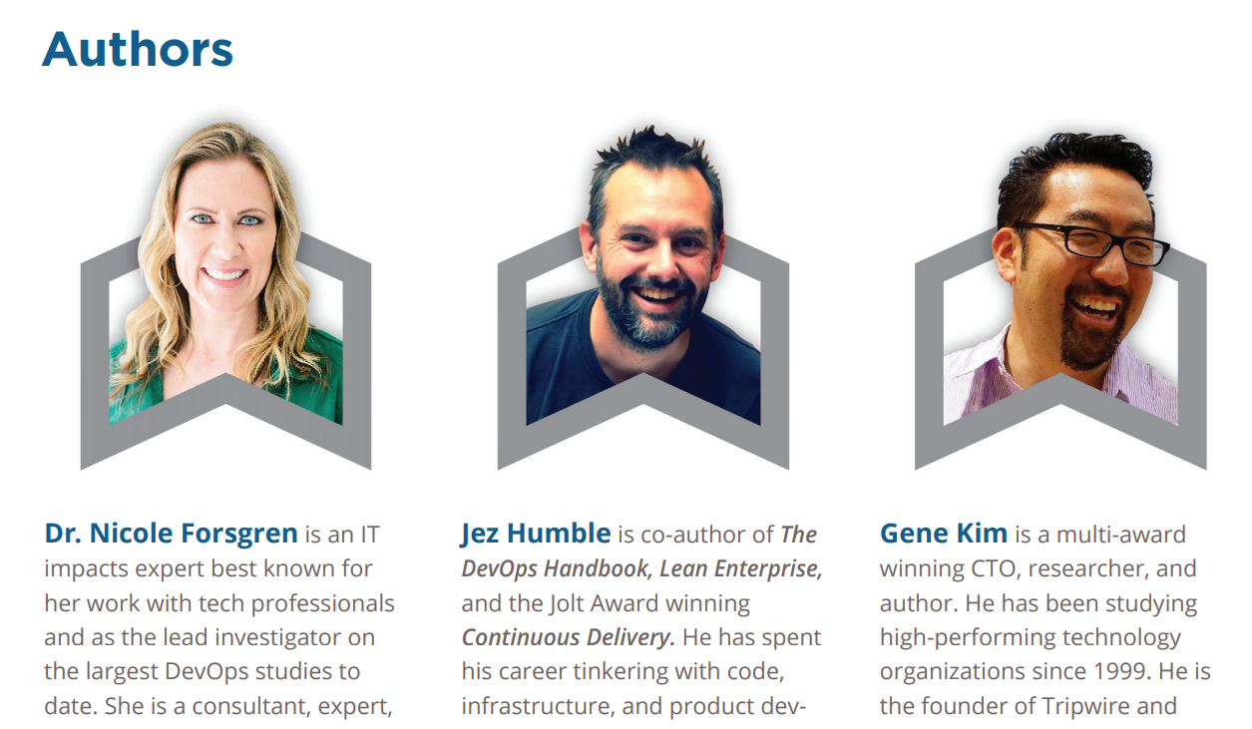
Measuring ROI of DevOps
https://services.google.com/fh/files/misc/dora_devops_roi_whitepaper.pdf
Notes:
We’ve talked at length about the benefits of DevOps, but some attendees may need to justify your transformation to key budget holders. This can be a daunting prospect. We recommend this whitepaper by Forsgren, Humble and Kim – who, between them, have authored or co-authored Continuous Delivery, The DevOps Handbook, The State of DevOps Reports, Accelerate and many other leading DevOps resources: https://services.google.com/fh/files/misc/dora_devops_roi_whitepaper.pdf

Slide 22
Agenda
PART 1 – INTROS
09:00 - Welcome
09:30 - A brief intro to DevOps
10:00 - Forking the repo
PART 3 – DEPLOYING DATABASES
13:00 - Database DevOps
13:30 - Exploring the tooling options
14:00 - Configuring an SSDT project
10:30 Morning break
PART 2 – DEPLOYING INFRASTUCTURE
11:00 - Using Octopus Runbooks to
manage infrastructure
12:00 Lunch
14:45 Afternoon Break
PART 4 – EXTENSIONS
15:15 - Redgate, DbUp, Entity Framework
16:30 - Q+A
17:00 End of day
Notes:
Now we’re all acquainted, let’s explore the agenda for the day.
Briefly talk through the agenda.
Key points:
Break times: Do these work for everyone?
Prerequisites: You should have completed the prerequisites and lab 1 in advance. But don’t worry if you haven’t. There aren’t any new labs before the 1st break. If anyone still need to create their accounts or complete lab 1 please do so during the 1st break. Also if anyone had any issues please send me a message and we can pick it up in the break.
We’ll start with a basic DevOps 101 crash course. Before we write any code, let’s make sure we understand why we are doing this at all and why it’s important/valuable.
Part 2 is all about the infrastructure. Deploying our infrastructure and using Source Control, PowerShell and Octopus Runbooks to automate and audit our SQL Server installations.
Part 3 is mainly theoretical. I’ll talk about the various different approaches to database source control and deployment and I’ll provide an overview of the most popular tools.
In part 4 we’ll create our first database deployment pipeline using SSDT, since it’s the most popular tool for SQL Server.
Finally, in part 5, we’ll look at some alternate database deployment pipelines and you’ll have the opportunity to try out whichever tools you are most intrigued by.
We’ll aim to finish our PoCs by 4.30 to allow us 30 minutes for general Q+A and conversation, before finishing at 5pm. However, if we don’t finish on time you own all the code, infra and training materials so you can continue to build and extend your PoC in your own time at your own convenience and we’ll be happy to help over email etc for the next week to ensure you complete your PoC.

Slide 23
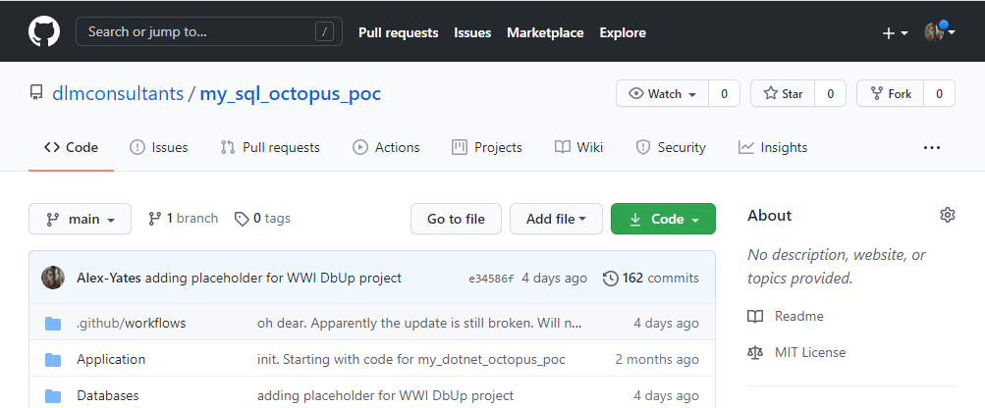
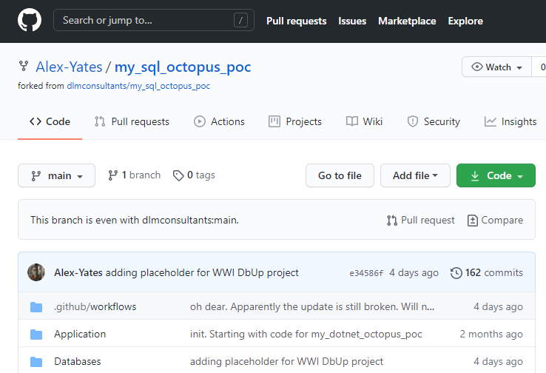
GitHub Forking
Forking the repo
Notes:
The first thing you need to do is fork the GitHub repo that contains all the code for today’s class.
This will create your own repo that you have complete control over. This is a safe place to experiment in isolation. If you break the code, you can just delete your fork and clone a fresh copy.
Also, if you have some experience using GitHub, and you spot any opportunities to improve the code, please feel free to submit a Pull Request. ;-)

Slide 24
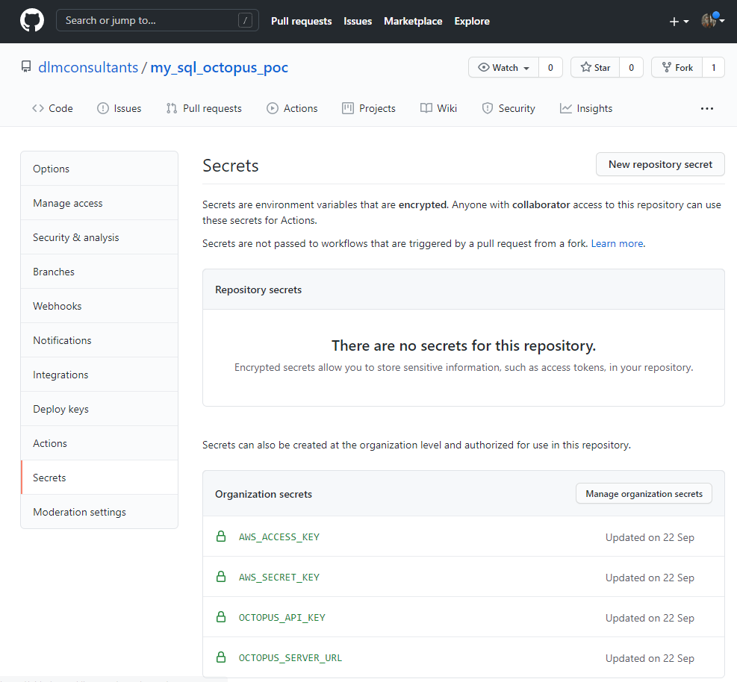
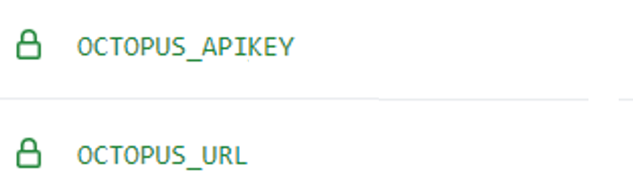
GitHub Secrets
Forking the repo
Notes:
Forking the repo is great, but in order to connect your GitHub fork with your Octopus Deploy instance, you need to create a couple of GitHub secrets.
GitHub secrets provide a safe way to store local config and passwords etc. You’ll need to create a couple of secrets with the URL and API KEY for your personal Octopus instance so that GitHub knows where to send all your packages. After all, it wouldn’t be very useful if you sent all your packages to my Octopus instance, and you certainly don’t want to be putting any of your credentials into the public source code!

Slide 25
LAB 1: Git 101: Forking the repo
Forking the repo
Tasks:
Fork GitHub repo
Create GitHub secrets
OCTOPUS_URL (e.g. “https://my_name.octopus.app/”)
OCTOPUS_APIKEY (e.g. “API-12345667890ABCDEFGHIJ”)
Notes:
Trainer to demo forking the repo from a public dlmconsultants / octopus GitHub repo into their own personal account.
Explore the repo and show where all the code lives and what it’s for. (Infra/Databases/Actions etc.)
Fork the repo into trainers personal account
Update the necessary secrets
Once demoed, leave time for attendees to fork the repo into their own github accounts and update their own variables/secrets.

Slide 26
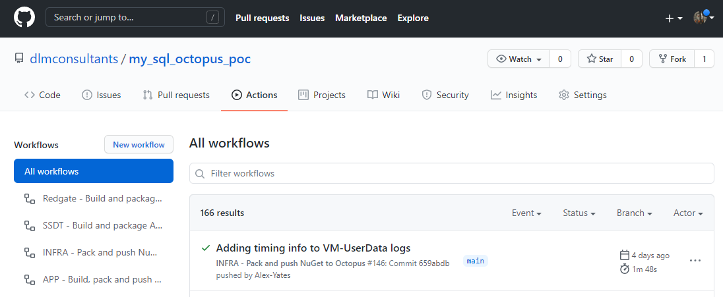
GitHub Actions
Forking the repo
Notes:
Intro to GitHub Actions: We’ll use these to build our packages and hand them over to Octopus deploy…
However, before you’ll be able to get these to work you’ll need to update one other thing… your secrets.
It might be worth taking some time to explain when you might use a Runbook, vs when you might use a GitHub Action:
Typically GitHub actions are used to perform tests/validation/publishing steps associated with changes to source code. This is different from Runbooks which are designed from an operational perspective. Runbooks are designed to support regular and routine operations that Ops folks may need to perform often.

Slide 27
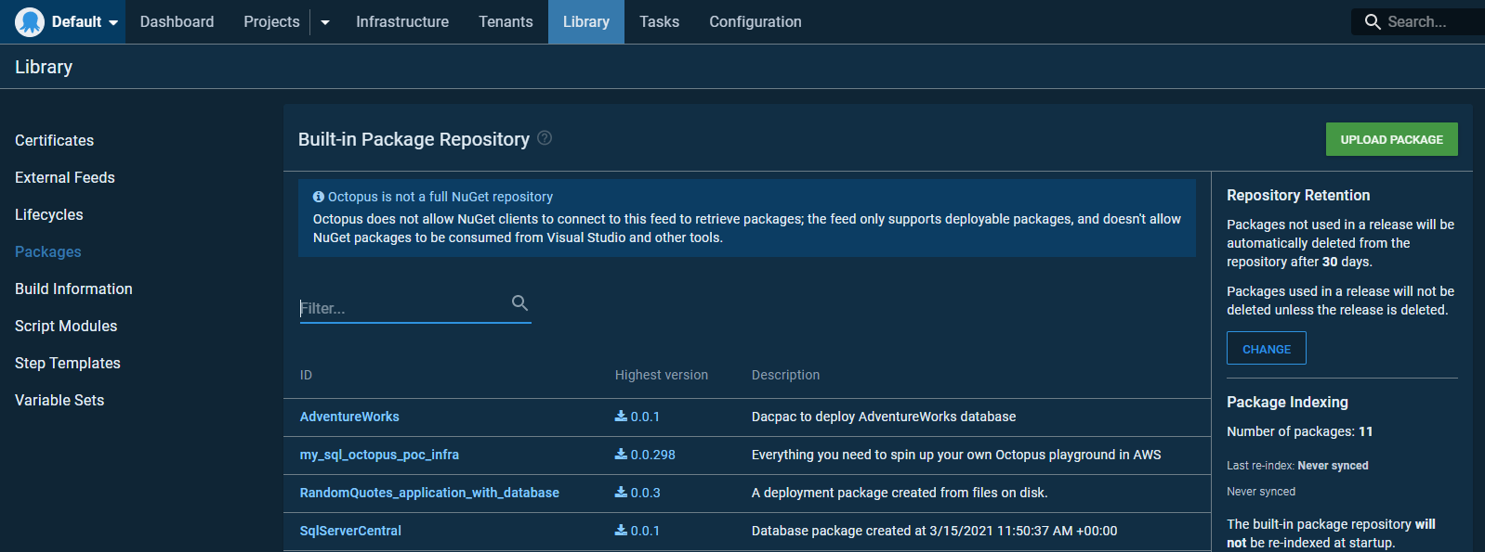
NuGet
Forking the repo
Notes:
Octopus has a built in NuGet repo.
Our GitHub Actions are going to package up our automation scripts and SQL Server projects and upload them into the Octopus Deploy NuGet feed.

Slide 28
LAB 2: Creating Packages
Forking the repo
Tasks:
Enable and run all GitHub Actions
Verify that they run. If any fail, read the logs, and look for any errors/warnings. What do they tell you? (HINT: Did the Action read your secrets correctly? Did you enter the secrets correctly?)
Notes:
Trainer to follow the lab manual and then leave some time for attendees to complete on their own machine.
Shouldn’t take long. Assuming all goes well it’s just a button click. Will be slower if folks run into problems and need a little help.
Explain what each of the four packages are for:
Infra (building all the AWS infrastructure)
SSDT and Redgate (sample databases using SSDT and Redgate projects)
App (sample webapp with a database deployed by Entity Framework Migrations)

Slide 29


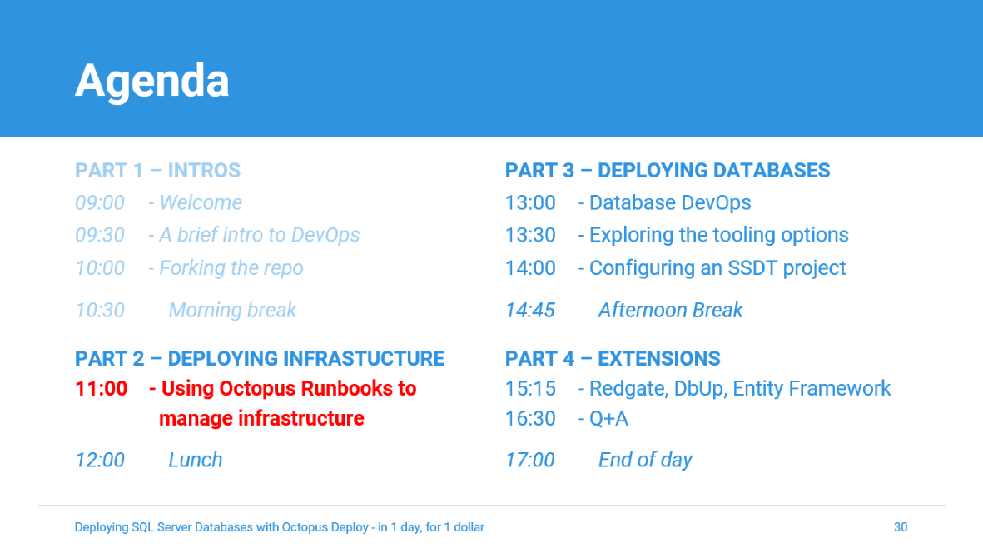
Coffee break: Re-starting at 11:00 If you haven’t already, please use this time to build and push your NuGet packages to Octopus
Notes:
Image source: https://libreshot.com/coffee-beans-2/
Image licence: https://libreshot.com/license-information/

Slide 30
Agenda
PART 1 – INTROS
09:00 - Welcome
09:30 - A brief intro to DevOps
10:00 - Forking the repo
PART 3 – DEPLOYING DATABASES
13:00 - Database DevOps
13:30 - Exploring the tooling options
14:00 - Configuring an SSDT project
10:30 Morning break
PART 2 – DEPLOYING INFRASTUCTURE
11:00 - Using Octopus Runbooks to
manage infrastructure
12:00 Lunch
14:45 Afternoon Break
PART 4 – EXTENSIONS
15:15 - Redgate, DbUp, Entity Framework
16:30 - Q+A
17:00 End of day
Notes:
Now we’re all acquainted, let’s explore the agenda for the day.
Briefly talk through the agenda.
Key points:
Break times: Do these work for everyone?
Prerequisites: You should have completed the prerequisites and lab 1 in advance. But don’t worry if you haven’t. There aren’t any new labs before the 1st break. If anyone still need to create their accounts or complete lab 1 please do so during the 1st break. Also if anyone had any issues please send me a message and we can pick it up in the break.
We’ll start with a basic DevOps 101 crash course. Before we write any code, let’s make sure we understand why we are doing this at all and why it’s important/valuable.
Part 2 is all about the infrastructure. Deploying our infrastructure and using Source Control, PowerShell and Octopus Runbooks to automate and audit our SQL Server installations.
Part 3 is mainly theoretical. I’ll talk about the various different approaches to database source control and deployment and I’ll provide an overview of the most popular tools.
In part 4 we’ll create our first database deployment pipeline using SSDT, since it’s the most popular tool for SQL Server.
Finally, in part 5, we’ll look at some alternate database deployment pipelines and you’ll have the opportunity to try out whichever tools you are most intrigued by.
We’ll aim to finish our PoCs by 4.30 to allow us 30 minutes for general Q+A and conversation, before finishing at 5pm. However, if we don’t finish on time you own all the code, infra and training materials so you can continue to build and extend your PoC in your own time at your own convenience and we’ll be happy to help over email etc for the next week to ensure you complete your PoC.

Slide 31
Our deployment checklist
Using Octopus Runbooks to manage infrastructure
Lab 3: Create an AWS user for Octopus
Create AWS Secrets for SQL passwords etc
Lab 4: Link Octopus to AWS
Lab 5: Create and configure our Octopus Project and Variables
Lab 6: Create an Octopus Runbook
Lab 7: Run the Octopus Runbook

Slide 32

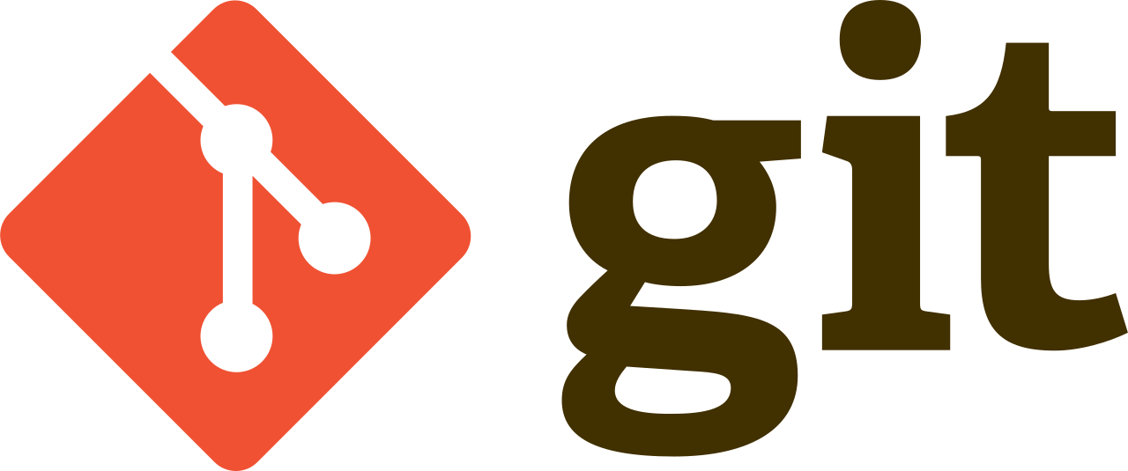



Overview: Source code and NuGet Packages
End to end demo
3.
1.
2.
All the source code for apps, databases and infra lives in GitHub
GitHub Actions build NuGet packages that contain all the artifacts required for deployment
NuGet packages are published to the built-in NuGet feed
Notes:
Talk through the high level process, including how GitHub, Octopus and AWS work together.
Then perform a “here’s one I made earlier” demo.
Do not get hung up on small tech details. Focus on how easy and cool it is to automate deploys.
This demo is about showing people the cool cherry. We’ve got the rest of the day to describe how the pastry is baked. No need to go into things like forking repos, managing secrets or creating keypairs here. Aim for as few button clicks as possible.
This demo is the hook, designed to grab folks attention, demonstrate at a high level how everything fits together, and demonstrate how the practical benefits of infra as code and auto deployments relate to the underlying DevOps theory, that we’ve just discussed.

Slide 33
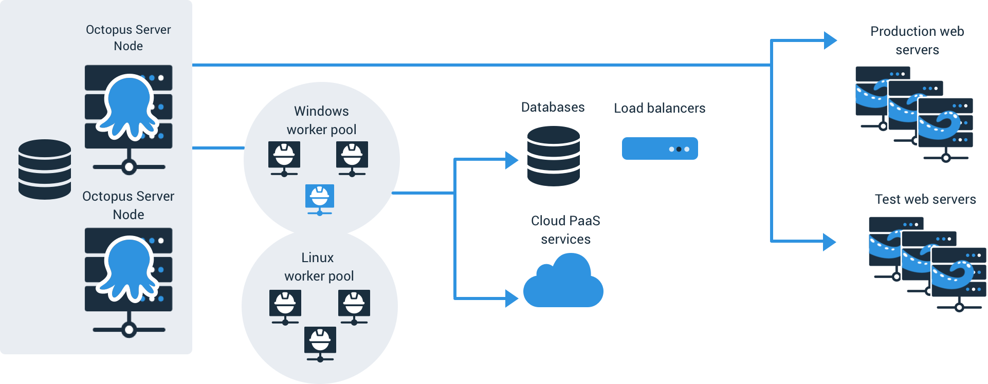
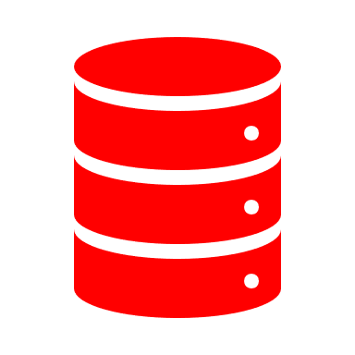

Overview: Infrastructure deployments
Using Octopus Runbooks to manage infrastructure
Octopus Cloud
1.
4.
2.
Octopus Worker
Web Servers
3.
Octopus leases a Dynamic Worker
Worker launches SQL and Web Servers
Worker launches SQL Jumpbox
Servers initialise: Tentacles, IIS, SQL install etc
Jump performs initial SQL setup
SQL Jumpbox
SQL Server
5.
Notes:
Let’s start by talking through the infrastructure that we’ll use for today’s class.
We start with your Octopus Server instance. For this class, it’s a Cloud instance but it could just as easily be an on-prem installation.
Our Octopus instance leases a dynamic worker. In real world applications you might want to use a specific tentacle or a specific worker pool, but for running generic AWS/Azure/GCP commands, Dynamic workers quite well. It might take an extra minute or so to lease the worker, but there’s a significantly lower admin overhead.
The worker runs a script that launches our web and SQL servers (if required). The scripts allow for any number of web servers for scalability, but the default is zero. We won’t actually look at the web stuff until the end of the class since our focus today is on SQL Server. However, the web servers are included here for completeness, and to demonstrate the differences between web and SQL deployments.
After the SQL Server instances has started, we read the SQL Server IP address and spin up a jumpbox.
Important side note: For simplicity, we are just using the dynamic public IP addresses that AWS assigns to us for each instance. However, since we are keeping our implementation as simple/minimal as possible, we aren’t bothering with a DNS server so we won’t have a consistent IP address/record/CNAME with which we can reference our SQL Server. This is why we need to wait until the SQL Server machine starts before we start the Jumpbox. It’s an ugly hardcoded dynamic IP address hack to keep the PoC as small and simple as possible.
4. All servers perform some initial setup tasks. All servers create a couple of users so that we can RDP and dig around. Web servers install and configure IIS. Web and Jump Servers install and configure Tentacles. SQL instance installs SQL Server, as well as a couple of other tools for our convenience, including SSMS.
5. The Jumpbox verifies that it can communicate with the SQL Server instance, using the IP address from step 2, and if required performs the initial creation of the databases that we’ll use for this class. The databases are empty at this point. We’ll deploy all the database objects and static data later.

Slide 34
Overview: Why use jumpboxes?
Using Octopus Runbooks to manage infrastructure
Security
Firewalls
Users/roles: Principle of least privilege
Resilience
Issues contained
Performance
Move additional workload off SQL instance
Audit/Admin
Source control/Infra as code
Notes:
Security:
SQL Server is behind the firewall
Access can be managed using users/roles
Resilience
Any issues with the DB tooling are contained on the jump server
Performance
Database deployment tooling, especially any database comparisons, can be performance intensive. Better to eat up CPU and memory on the Jumpbox than the production database server
Audit/Admin
Jumpboxes are easily version controlled, disposable and re-deployable on demand

Slide 35
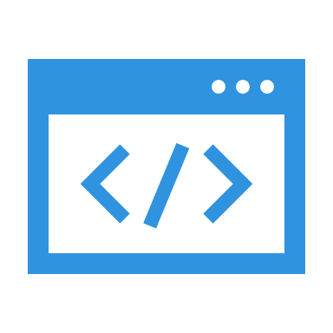
Overview: Code deployments
Using Octopus Runbooks to manage infrastructure
Octopus Cloud
1.
Web Servers
NuGets deployed to Web/Jump servers
Web servers deploy web application
Jump server runs DB Deployment script
DB deploy tool on Jump server executes DB deployment
SQL Jumpbox
SQL Server
2.
Notes:
Once all our servers are ready, we’ll be able to deploy our NuGet packages directly from our Octopus Cloud instances to the tentacles running on our Web and Jump Servers.
The Tentacles can then unpack and deploy those NuGets. For database deployments, the Jumpboxes will run scripts on the jumpboxes that will instruct various database deployment tools to perform the deployments against the SQL Server instance.

Slide 36
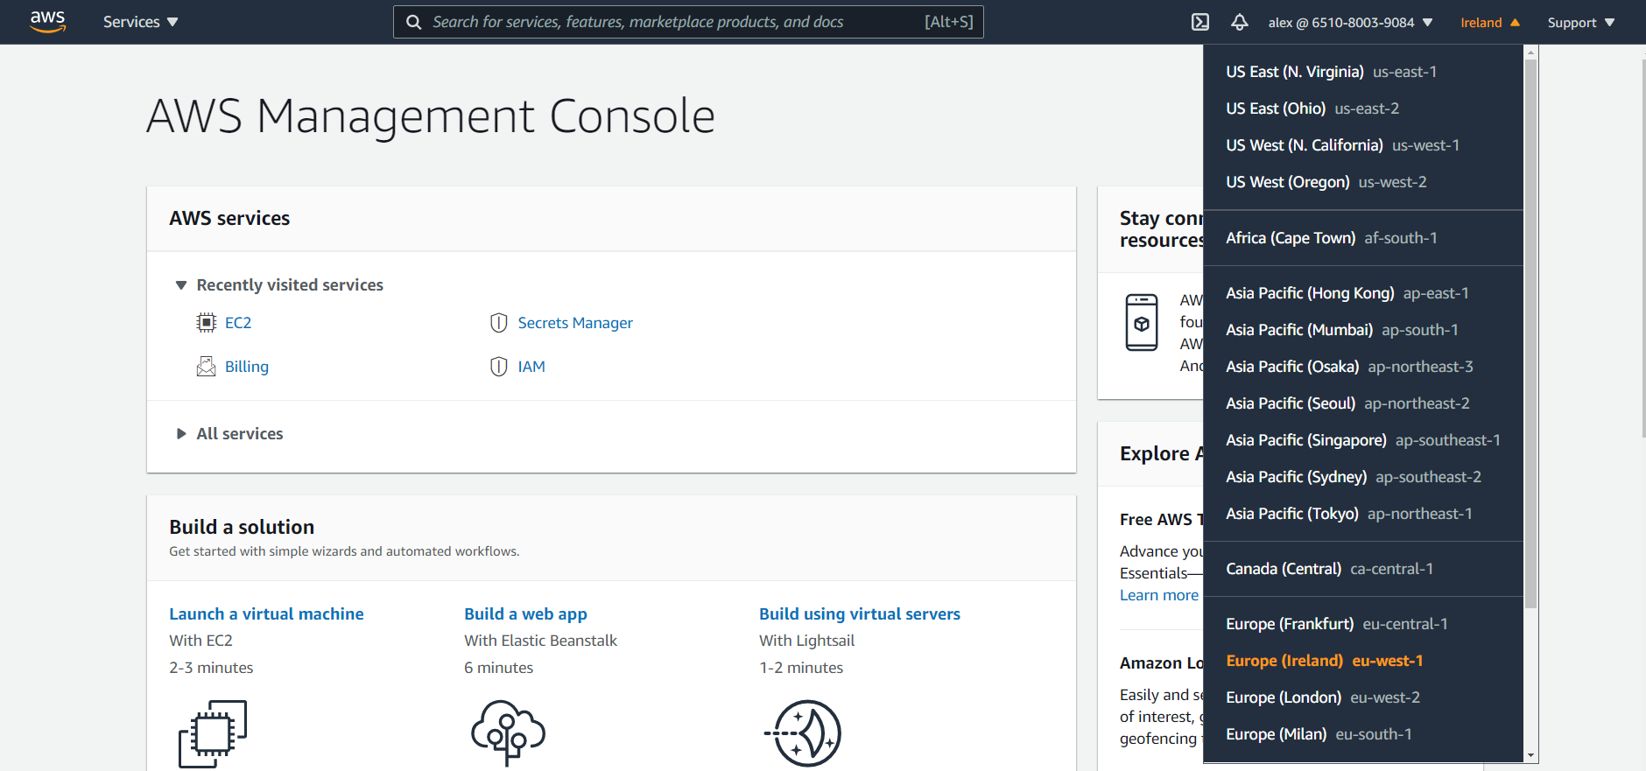
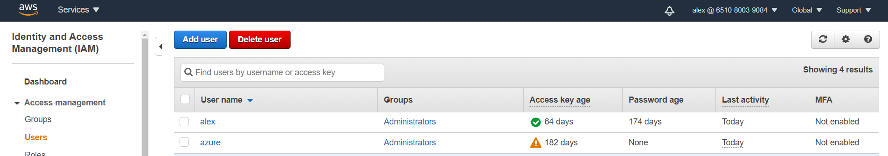
AWS 101: Regions
Using Octopus Runbooks to manage infrastructure
Notes:
When you create your AWS account, you will only have a single admin user. This user is God and can do anything it wants. Hence, it’s good practice to try to use it as little as possible.
AWS best practice is to create an IAM user for yourself for general work, even if you grant yourself admin rights. You can also create IAM users for other folks who will use your AWS account, as well as separate accounts for each of the automated services that you use (such as Octopus Deploy or Azure DevOps Services). For example, I’ve also created an account for my bookkeeper (not included in this screenshot) and I’ve granted her access to all the billing and finance information.

Slide 37
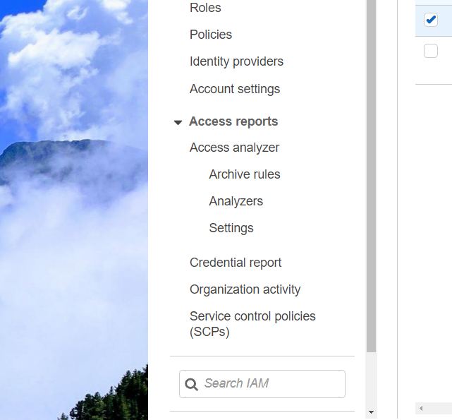
AWS 101: IAM Users
Using Octopus Runbooks to manage infrastructure
Notes:
When you create your AWS account, you will only have a single admin user. This user is God and can do anything it wants. Hence, it’s good practice to try to use it as little as possible.
AWS best practice is to create an IAM user for yourself for general work, even if you grant yourself admin rights. You can also create IAM users for other folks who will use your AWS account, as well as separate accounts for each of the automated services that you use (such as Octopus Deploy or Azure DevOps Services). For example, I’ve also created an account for my bookkeeper (not included in this screenshot) and I’ve granted her access to all the billing and finance information.

Slide 38
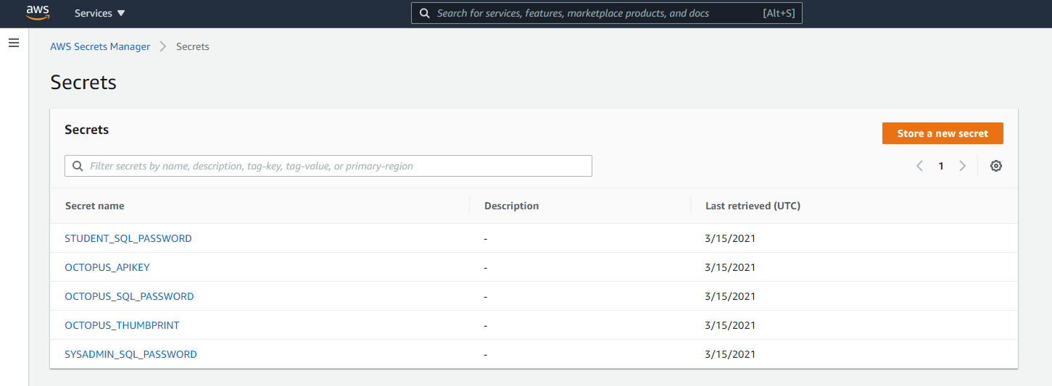
AWS 101: Secrets Manager
Using Octopus Runbooks to manage infrastructure
Notes:
We can use secrets manager to save a few secrets that we’ll need.
Once you’ve created a secret, you can retrieve the passwords using an API. We are going to do this during our class as we automate various tasks (e.g. the creation of users and the installation configuration of our SQL Server instances).

Slide 39
LAB 3: Preparing AWS
Using Octopus Runbooks to manage infrastructure
Tasks:
Create an AWS user for Octopus
Create the following AWS Secrets:
OCTOPUS_THUMBPRINT (Find this in Octopus under “Configuration”)
OCTOPUS_APIKEY (Create one on your Octopus profile page)
STUDENT_SQL_PASSWORD (D3vOpsRocks!)
OCTOPUS_SQL_PASSWORD (5re4lsoRocks!)
SYSADMIN_SQL_PASSWORD (S4fePa55word!!!)
COST WARNING: At the time of writing (Jan 2021) AWS Secrets will cost you $0.40/month each.
(See Appendix 1 in the lab manual for more details on licencing.)
Notes:
Trainer to follow the lab manual and then leave some time for attendees to complete on their own machine.
Try to use the scripts for it to minimise human error mistakes, but demonstrate the changes in the web portal so that attendees know how to verify whether they have completed the tasks successfully.

Slide 40
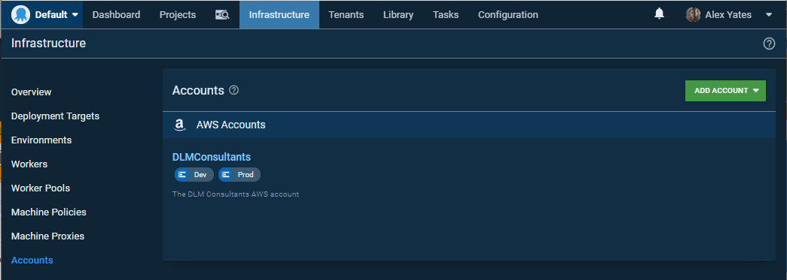
LAB 4: Preparing Octopus
Using Octopus Runbooks to manage infrastructure
Notes:
Trainer to follow the lab manual and then leave some time for attendees to complete on their own machine.

Slide 41
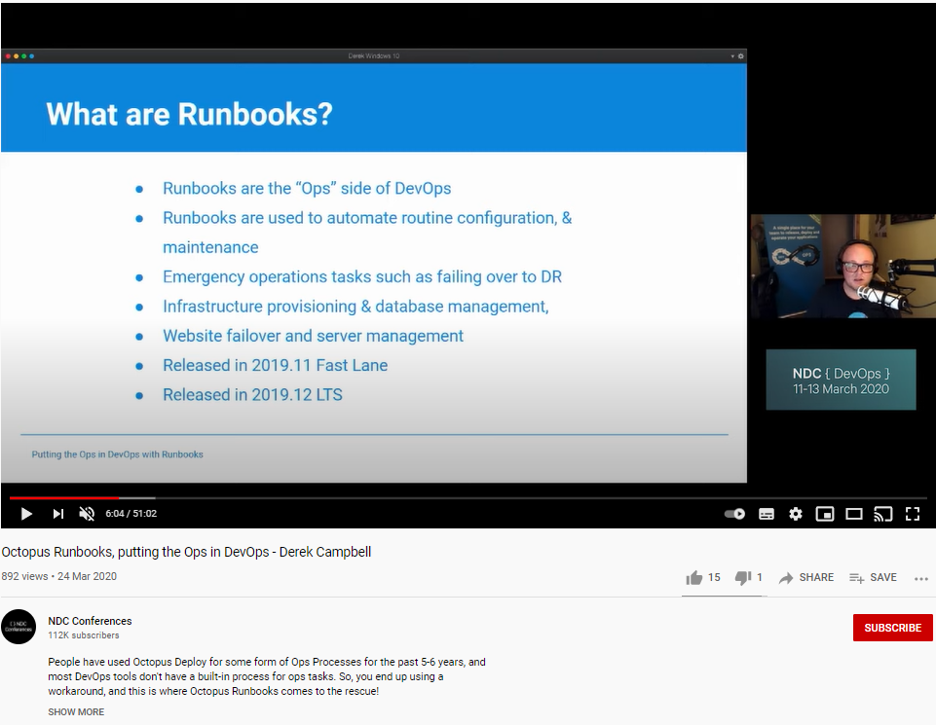
What are Runbooks in Octopus Deploy?
Using Octopus Runbooks to manage infrastructure
The “Ops” side of DevOps
Automate routine config and maintenance
Emergency operations (e.g. failing over to DR)
Infra provisioning and DB management
Website failover and server management
Released in 2019.11 Fast Lane
Released in 2019.12 LTS
More info: https://www.youtube.com/watch?v=Z1gWfvPXDQo (Thanks Derek!)

Slide 42
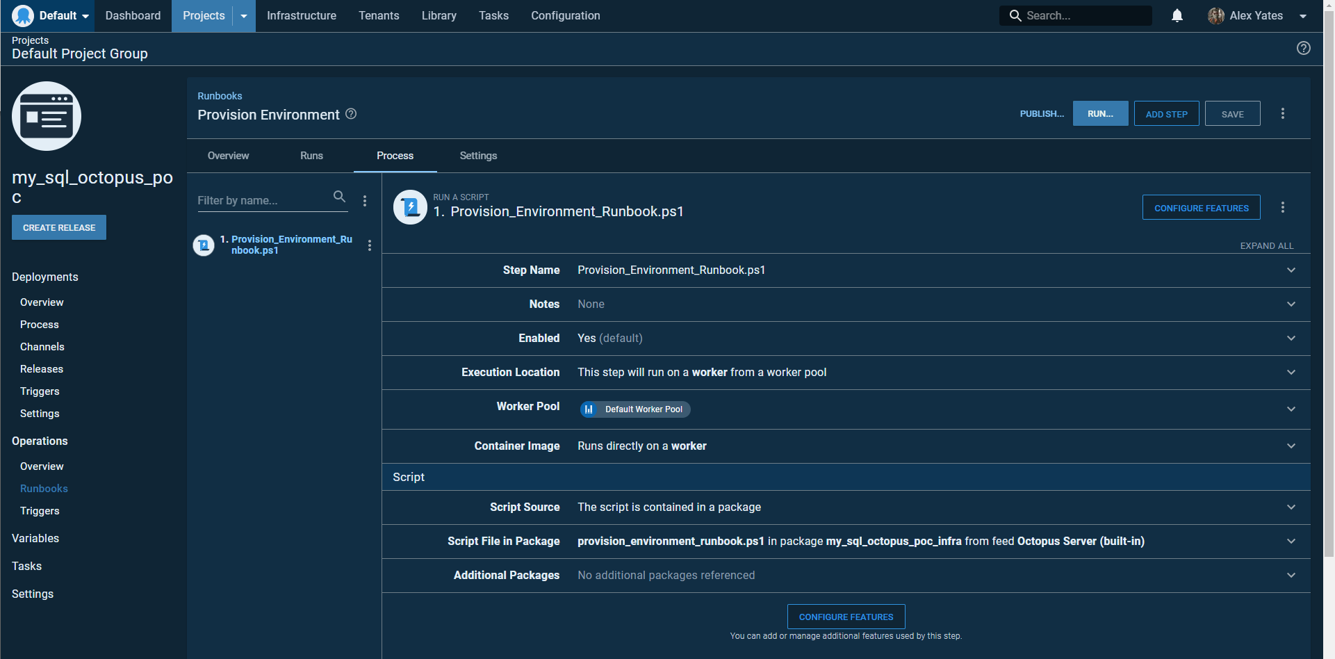
Understanding this Runbook
Using Octopus Runbooks to manage infrastructure
Run a Script…
… on dynamic, hosted worker.
Script is in the my_sql_octopus_poc NuGet package

Slide 43
Understanding the script
Using Octopus Runbooks to manage infrastructure
~my_sql_octopus_poc\Infrastructure\provision_environment_runbook.ps1
.\helper_scripts\install_AWS_tools.ps1
.\helper_scripts\configure_default_aws_profile.ps1
.\helper_scripts\create_aws_role.ps1
.\helper_scripts\create_keypair.ps1
.\helper_scripts\add_role_to_profile.ps1
.\helper_scripts\create_security_group.ps1
.\helper_scripts\build_servers.ps1
# 1. Initialising variables etc #
# 2. Determine how many machines need to be added/deleted #
# 3. Removing everything that needs to be deleted #
# 4. Adding anything that needs to be added #
# 5. Installing dbatools so that we can ping SQL Server #
# 6. Waiting until everything comes back online #
# 7. Verify that we have the correct number of machines #
Octopus worker setup
AWS/security setup
Building infrastructure

Slide 44
Other ways to build your infra
CloudFormation
ARM Templates (Azure)
ACI (Docker Containers in Azure)
Puppet
Chef
Terraform
Hashicorp Packer
etc

Slide 45
LAB 5: Octopus Projects and Variables
Using Octopus Runbooks to manage infrastructure
Tasks:
Create a my_sql_octopus_poc project.
Create the following variables:
OCTOPUS_APIKEY (Create one on your Octopus profile page)
OCTOPUS_SQL_PASSWORD (5re4lsoRocks!)
AWS_ACCOUNT (Reference the account you created earlier)
AWS_REGION (Optional. For example: eu-west-1.)
Notes:
Trainer to follow the lab manual and then leave some time for attendees to complete on their own machine.

Slide 46
LAB 6: Creating an Octopus Runbook
Using Octopus Runbooks to manage infrastructure
Tasks:
Create a “Provision Environment” runbook.
Add a “Run a Script” step.
Reference the provision_environment_runbook.ps1 script from the my_sql_octopos_poc NuGet package.
Repeat steps 1-3 for: kill_environment_runbook.ps1
Notes:
Trainer to follow the lab manual and then leave some time for attendees to complete on their own machine.

Slide 47
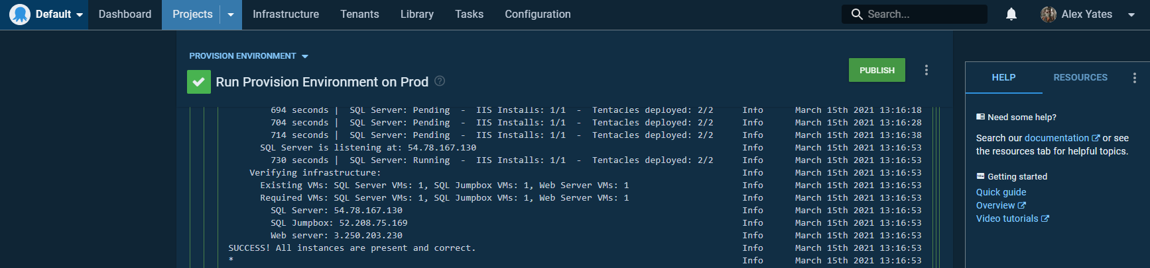
LAB 7: Running a Runbook
Using Octopus Runbooks to manage infrastructure
Tasks:
Execute your runbook against Dev and Prod to verify that it works for both environments.
COST WARNING: Building your Dev and Prod environments will cost you money.
By default, each environment will consist of one t2.micro instance. At the time of writing (Jan 2021), in eu-west-1, each t2.micro instance will cost you $0.0116/hour.
(See Appendix 1 in the lab manual for more details on licencing.)
Notes:
Trainer to follow the lab manual and then leave some time for attendees to complete on their own machine.
Note: Calamari will almost always require an update. This will be done automatically the first time you deploy anything.

Slide 48
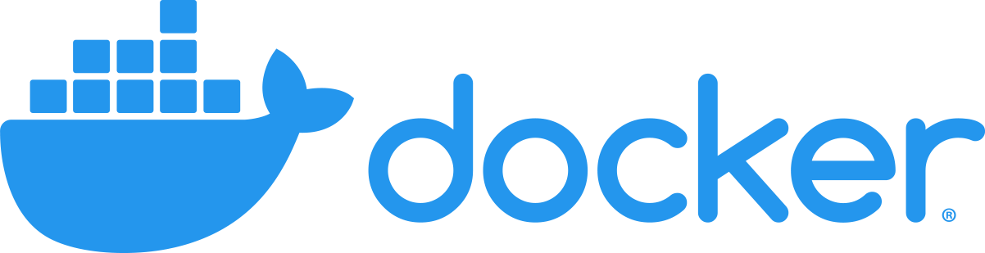
Honourable mention: Containers!
Using Octopus Runbooks to manage infrastructure
Notes:
We would have used docker in this class, however, t2.micro EC2 images do not have the necessary resources to pull SQL Server docker images.
[Short description of Docker.]
Since we can’t use docker, our runbook installs a full fat version of SQL Server Developer edition. In a real-world example, where you have access to more resources, you may find it easier to use docker containers.

Slide 49
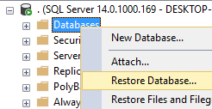
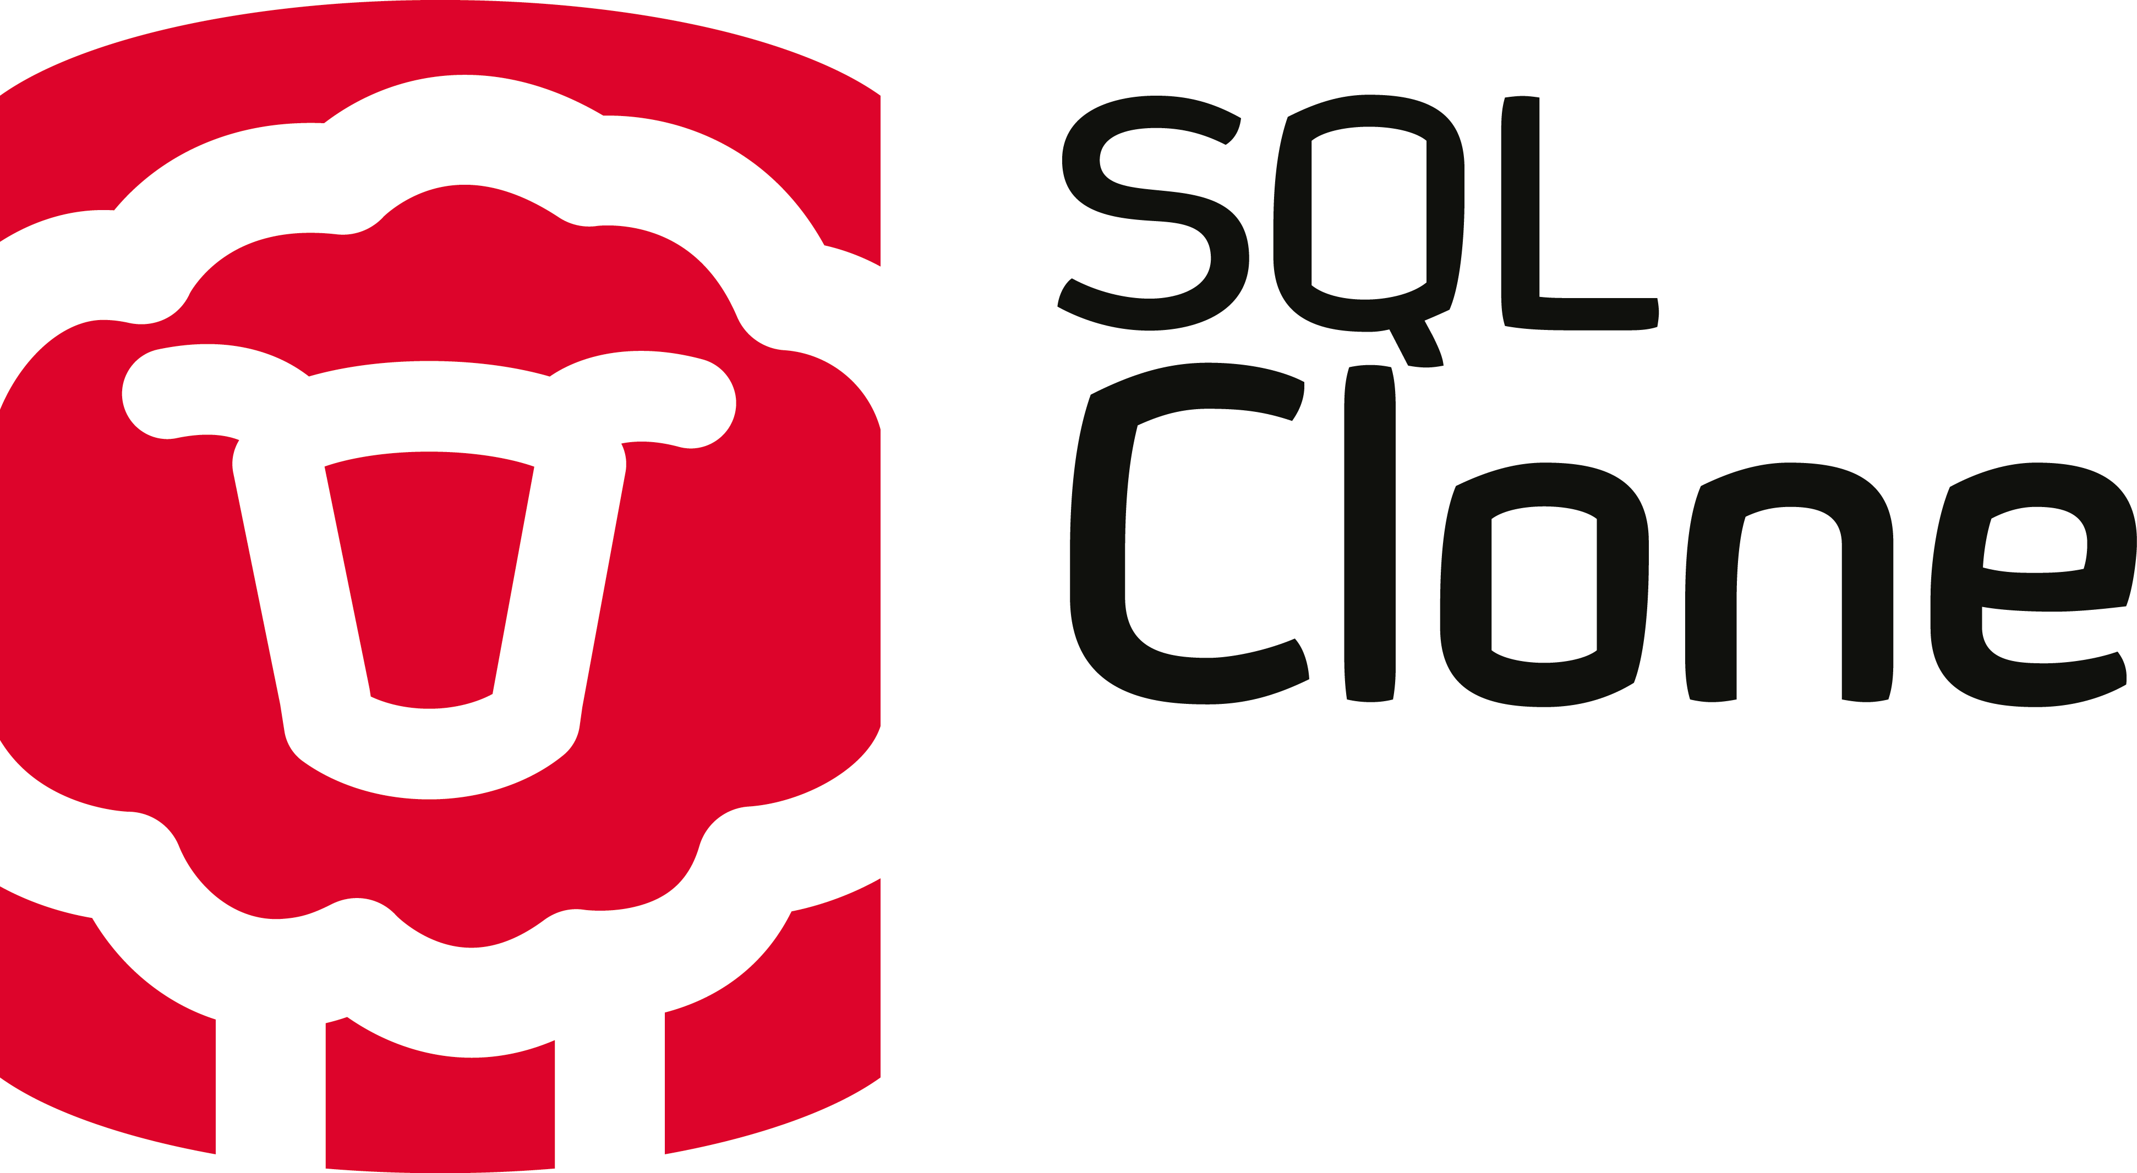
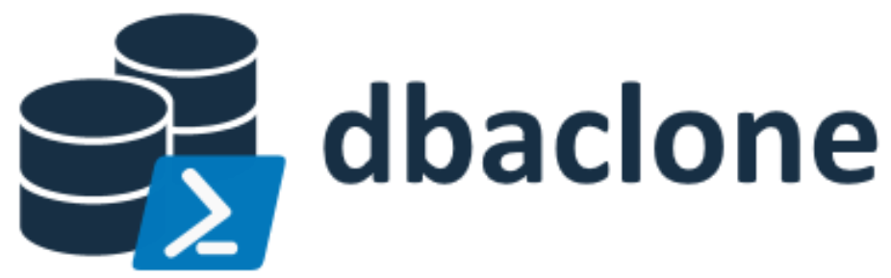
Provisioning databases
Using Octopus Runbooks to manage infrastructure
Notes:
Our runbook uses dbatools to create empty databases and we’ll deploy the schema from our source code later.
However, it might be beneficial to do the initial provisioning with databases that match production as closely as possible.
A few ways folks like to approach this include:
Restoring a recent production backup (but this may take a long time and require a lot of space)
Redgate SQL Clone, which allows users to instantly create virtual copies of editable 64TB databases, using only 50MB, in a few seconds
dbaclone, which does the same thing as SQL Clone for free, but which lacks some of the administrative, data protection and usability benefits that come with the Redgate tool

Slide 50
Data Privacy and Dev/Test Databases
Using Octopus Runbooks to manage infrastructure
Best for Dev/Test
Production data
Masked Data
Curated Data
Generated Data
No Data
FirstName | LastName | Midichlorians
Anakin | Skywalker | 27000
Luke | Skywalker | 25000
Leia | Organa Solo | 25000
Obi-Wan | Kenobi | 12500
Han | Solo | 2500
Easiest to do
Notes:
When provisioning the databases, we also need to think about data privacy. Regardless of whether a dev/test database is a shared resource or a dedicated instance for a specific developer/task, we need to strip out the sensitive data.
There are various ways to do this. The more effort you put in, the more realistic and trustworthy your dev and test efforts are likely to be.
Let’s imagine this random star wars data was our production sensitive health data. Obviously, the best thing for developers/testers is the real data. However, due to data privacy concerns, that’s probably not an option. If you are fortunate enough to work with public/insensitive data, perhaps you can just use production data. However, for most of us, that’s not an option.

Slide 51
Data Privacy and Dev/Test Databases
Using Octopus Runbooks to manage infrastructure
Best for Dev/Test
Production data
Masked Data
Curated Data
Generated Data
No Data
FirstName | LastName | Midichlorians
Bob | Smith | 27000
Daniel | Smith | 25000
Katie | Jones | 25000
Peter | Taylor | 12500
Sam | Brown | 2500
Easiest to do
Notes:
The best thing we could probably do is mask the production data. This should retain accurate references, distributions and all the nasty real-world inconsistencies that help you to spot potential issues. However, it has it’s challenges:
Referential integrity: When the names and genders don’t match, or when the orders don’t match the contact information, you can create technical challenges and it becomes tricky to figure out if the odd results from a query are the results of bad code or bad data. These problems are solvable, but it takes effort.
Reidentification risk: If you hold a US citizen’s zip code and date of birth, you can almost always reidentify them using publicly available data. As long as you retain real sensitive data, it’s important to ensure that your data is sufficiently well masked that the data subjects cannot be reidentified. This is hard, and carries the risk that you’ve made a mistake.
Since this is an effective “production by default” approach, it needs constant review/care. Should be backed up with proper data classification and documentation processes. These are all things folks should be doing anyway, but which are almost always not up to date.

Slide 52
Data Privacy and Dev/Test Databases
Using Octopus Runbooks to manage infrastructure
Best for Dev/Test
Production data
Masked Data
Curated Data
Generated Data
No Data
FirstName | LastName | Midichlorians
Testy | McTestface | 7500
Easiest to do
Notes:
Curated data is essentially a bunch of known test cases that are added to the database. These can be useful independently and separately from bulk/masked/production data. However, without any bulk data it becomes hard to test whether code will work with the scale and imperfect nature of production workloads. Test-cases are almost always going to be limited in scope and it’s practically impossible to create it in any large quantities.
Curated data can be useful, for example, for developers and testers to know of a few test cases in the system with specific properties, allowing developers to test against known test cases.
Curated data can either be used without any bulk data, or in addition to it.

Slide 53
Data Privacy and Dev/Test Databases
Using Octopus Runbooks to manage infrastructure
Best for Dev/Test
Production data
Masked Data
Curated Data
Generated Data
No Data
FirstName | LastName | Midichlorians
Janet | Wilson | 16000
Theo | Johnson | 3000
Sarah | Cooper | 6500
Arthur | Wilson | 19500
Easiest to do
Notes:
Data can be generated, either from a script or using a tool fairly easily. However, it’s never going to be as realistic as real production or masked data. This makes it difficult for developers and testers to trust it. Production data is likely to have different distributions of data and specific quircks etc that need to be handled. It’s unlikely that generated data will ever by “dirty” and imperfect in all the strange ways that real world data can be.
On the plus side, if 100% of the production data is swapped out for generated data, data privacy becomes much easier to manage.

Slide 54
Data Privacy and Dev/Test Databases
Using Octopus Runbooks to manage infrastructure
Best for Dev/Test
Production data
Masked Data
Curated Data
Generated Data
No Data
FirstName | LastName | Midichlorians
Easiest to do
Notes:
Finally, you could strip out all the data. That’s quick and easy to do but makes it almost impossible to perform any realistic dev/test work. That will increase the risk of errors, which in itself is a data protection risk.

Slide 55
Data Privacy and Dev/Test Databases
Using Octopus Runbooks to manage infrastructure
Best for Dev/Test
Production data
Masked Data
Curated Data
Generated Data
No Data
FirstName | LastName | Midichlorians
Easiest to do
Notes:
For this reason, “no data” needs to be basically struck off the list of realistic options for most cases.

Slide 56
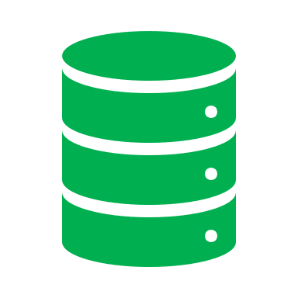

Data Privacy and Dev/Test Databases
Using Octopus Runbooks to manage infrastructure
PUBLIC DOMAIN
SENSITIVE DATA
TEST
DEV
PROD
TEST
DEV BASE IMAGE
STAGING AREA
Notes:
Regardless of your data masking strategy, the process probably looks something like this:
We start with production
We imagine a boundary between the secure and thepublic domain. All developers live in the public domain.
We make a copy of the production database, and then we run our masking routines on it to create a public version of it. This process is probably an automated weekly job and is also a great excuse to automate regular backup restores.
We make that public copy of the production database available in the public/dev domain.
At this point we can kill the staging area. It’s served it’s purpose.
Now developers are free to spin up and tear down their dev databases as and when they need them without any interaction from DBAs. They treat their dev servers like cattle, not pets, never keeping them around for very long.
Changes are committed to source control.
Packages are generated and handed off to Octopus.
Octopus can then deploy updates to the more senior environments, whether they live on the public or private side of the fence.
Notes: The base dev image will need to be updated on a regular basis to avoid it getting too out of sync with the main branch in source control. It should probably be automated as a routine weekend job or at the end of a sprint, for example.
Itf using a cloning tool like SQL Clone or dbaclone, it would be beneficial to hold on to one old dev base image at any one time ince any clones will be lost when the base image is purged. However, it would be healthy to force developers to reprovision clones on a regular basis so you shouldn’t need more than one old image.

Slide 57


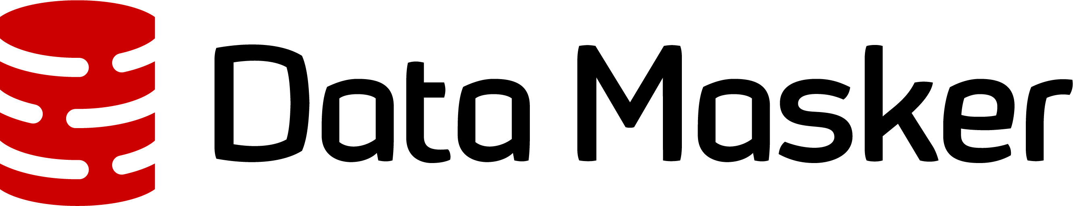
Data Privacy tools
Using Octopus Runbooks to manage infrastructure

Slide 58

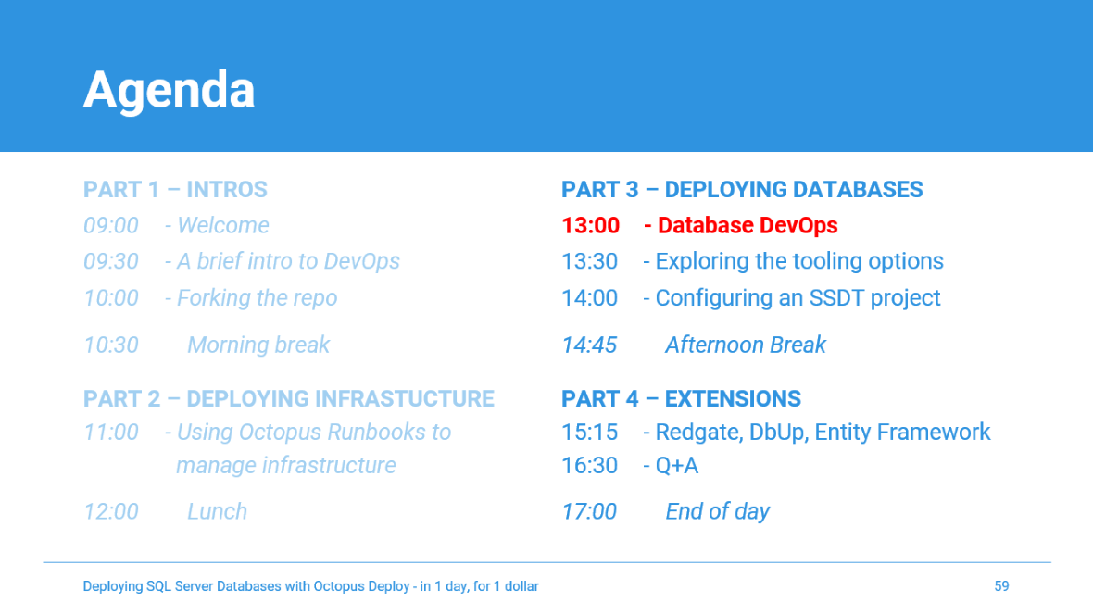
Lunch time: Re-starting at 13:00 Want to learn more? Check out the additional reading for each of the labs!
Notes:
Image source: https://www.flickr.com/photos/30478819@N08/40382097833
Image licence: https://creativecommons.org/licenses/by/2.0/

Slide 59
Agenda
PART 1 – INTROS
09:00 - Welcome
09:30 - A brief intro to DevOps
10:00 - Forking the repo
PART 3 – DEPLOYING DATABASES
13:00 - Database DevOps
13:30 - Exploring the tooling options
14:00 - Configuring an SSDT project
10:30 Morning break
PART 2 – DEPLOYING INFRASTUCTURE
11:00 - Using Octopus Runbooks to
manage infrastructure
12:00 Lunch
14:45 Afternoon Break
PART 4 – EXTENSIONS
15:15 - Redgate, DbUp, Entity Framework
16:30 - Q+A
17:00 End of day
Notes:
Now we’re all acquainted, let’s explore the agenda for the day.
Briefly talk through the agenda.
Key points:
Break times: Do these work for everyone?
Prerequisites: You should have completed the prerequisites and lab 1 in advance. But don’t worry if you haven’t. There aren’t any new labs before the 1st break. If anyone still need to create their accounts or complete lab 1 please do so during the 1st break. Also if anyone had any issues please send me a message and we can pick it up in the break.
We’ll start with a basic DevOps 101 crash course. Before we write any code, let’s make sure we understand why we are doing this at all and why it’s important/valuable.
Part 2 is all about the infrastructure. Deploying our infrastructure and using Source Control, PowerShell and Octopus Runbooks to automate and audit our SQL Server installations.
Part 3 is mainly theoretical. I’ll talk about the various different approaches to database source control and deployment and I’ll provide an overview of the most popular tools.
In part 4 we’ll create our first database deployment pipeline using SSDT, since it’s the most popular tool for SQL Server.
Finally, in part 5, we’ll look at some alternate database deployment pipelines and you’ll have the opportunity to try out whichever tools you are most intrigued by.
We’ll aim to finish our PoCs by 4.30 to allow us 30 minutes for general Q+A and conversation, before finishing at 5pm. However, if we don’t finish on time you own all the code, infra and training materials so you can continue to build and extend your PoC in your own time at your own convenience and we’ll be happy to help over email etc for the next week to ensure you complete your PoC.

Slide 60
Database DevOps: A world without DevOps…

Slide 61






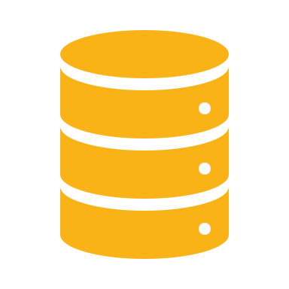
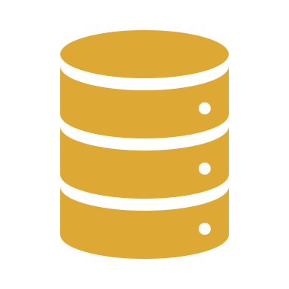
The 9 Levels of Database DevOps Hell
DevOps and Databases
TO DO!
Get shiny image from octopus graphic design team.
Level 0: Data
Level 1: Dependencies
Level 2: Global failures
Notes:
Basically, summarise my Database Delivery Hell blog post:
https://github.com/OctopusDeploy/blog/blob/master/blog/2021-07/safe-schema-updates-1-delivery-hell/index.md
Let’s talk about some of the specific dev and ops concerns relating to databases:
0: Data – Persistence issues, data loss, cannot drop/create the database. Arguably it’s pets, rather than cattle. Also, data privacy concerns. Data breaches cannot be undone. Creating realistic dev data is hard and usually underinvested in so devs often end up using bad data, sensitive data or no data. They also typically have to jump through hoops and wait ages to get hold of it. This undermines dev/test processes, making production database failures even more likely.
1: Dependencies – Databases tend to be the glue that binds big-ball-of-mud monoliths together. Navigating the web of dependencies is perilous.
2: Globel failures – Due to points 0 and 1, changes in the database can have unintended and hard to revert, cascading consequences.

Slide 62






The 9 Levels of Database DevOps Hell
DevOps and Databases
TO DO!
Get shiny image from octopus graphic design team.
7.
8.
Level 0: Data
Level 1: Dependencies
Level 2: Global failures
Level 3: Release co-ordination
Level 4: Downtime windows
6.
5.
4.
3.
1.
2.
Notes:
3: Release co-ord – Due to all dependencies, releases often need to be carefully planned, ordered and manually orchestrated.
4: Downtime windows –Consequently, deployments take time. We need to take the system offline to perform deploys. Missing your downtime window is likely toi be bad, so deployments are stressful and against the clock. Hardly the best condition for success.

Slide 63






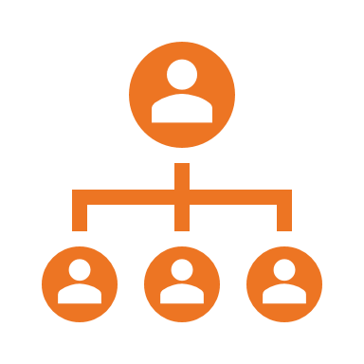
The 9 Levels of Database DevOps Hell
DevOps and Databases
TO DO!
Get shiny image from octopus graphic design team.
Level 0: Data
Level 1: Dependencies
Level 2: Global failures
Level 3: Release co-ordination
Level 4: Downtime windows
Level 5: Bureaucracy
Notes:
5: Bureacracy - Users and other stakeholders don’t like downtime windows and are risk averse, so they bog the process down with endless tests and redtape. This is in the name of safety but is counter productive since deployments get held up, so more changes get piled up for review in big batches, leading to bigger, more challenging and riskier deploys, longer downtime windows, more failure, more red-tape, and so the vicious circle continues.

Slide 64

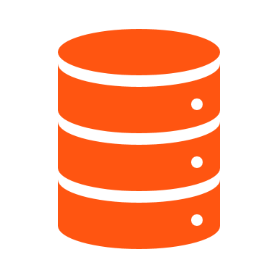


The 9 Levels of Database DevOps Hell
DevOps and Databases
TO DO!
Get shiny image from octopus graphic design team.
Level 0: Data
Level 1: Dependencies
Level 2: Global failures
Level 3: Release co-ordination
Level 4: Downtime windows
Level 5: Bureaucracy
Level 6: Disobedience of bureaucracy
Notes:
6: Disobedience: Since the bureaucracy becomes stifling, but the deadlines keep coming, folks come up with ever more inventive ways to avoid scrutiny. The oversight that the bureaucracy relies on is lost and chaos ensues. Shadow IT flourishes. Culture of secrecy, cheating and corruption emerges. Any hope of co-ordination and collaboration is lost. Folks at all levels are more concerned about personal goals and the success of their close allies, often at the expense of the broader goals. Systems thinking and lean ideas seem impractical or naïve.

Slide 65









The 9 Levels of Database DevOps Hell
DevOps and Databases
Level 0: Data
Level 1: Dependencies
Level 2: Global failures
Level 3: Release co-ordination
Level 4: Downtime windows
Level 5: Bureaucracy
Level 6: Disobedience of bureaucracy
Level 7: Negligence
Notes:
7: Negligence – Lack of care for global objectives results in hyper focus on limited tasks at the expense on general health keeping tasks. Improvement projects are cut to focus on delivering the next feature. Testing is scrapped. Monitoring/telemetry is ignored. Servers aren’t patched. Stuff starts to fail more often.

Slide 66


The 9 Levels of Database DevOps Hell
DevOps and Databases
Level 0: Data
Level 1: Dependencies
Level 2: Global failures
Level 3: Release co-ordination
Level 4: Downtime windows
Level 5: Bureaucracy
Level 6: Disobedience of bureaucracy
Level 7: Negligence
Level 8: The Technical Debt Singularity
Notes:
8: Tech debt singularity – [May require a an explanation of both the terms “technical debt” and “singularity”.] Owing to the lack of improvement work or even basic maintenance, the amount of firefighting gradually increases. Eventually it takes up 100% of dev time. Perhaps more than 100%, with teams relying on overtime and burning out their engineers to stay afloat. There is no time left for new work – and anything that is created further adds to the firefighting overheads.
Throwing more engineers at the problem won’t help – it’ll just accelerate the rot. See “The Mythical Man Month”.
You’ve reached the bottom of the pit. Something is going to change. Either the org will change it’s ways, or it will be beaten by more capable competition.

Slide 67
Database DevOps: Core ideas…

Slide 68
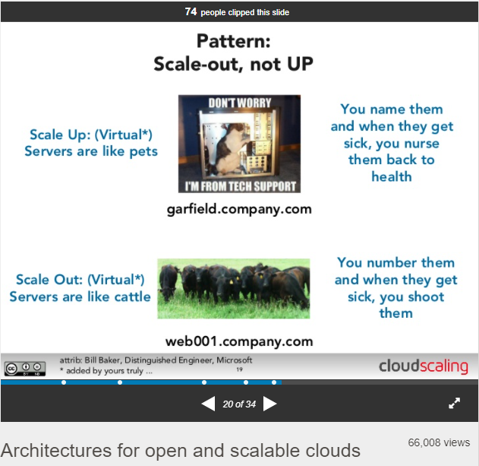
Protecting the data
Automating databases: The basics
Cattle (Infra/Engine) vs Pets (Data)
https://www.slideshare.net/randybias/architectures-for-open-and-scalable-clouds/20
Notes:
With databases, it’s all about protecting the data.
Databases are not like web apps. We cannot lose the data.
This poses challenges to traditional DevOps thinking that seeks to treat servers like disposable cattle. It’s a great goal, but databases are more challenging.

Slide 69
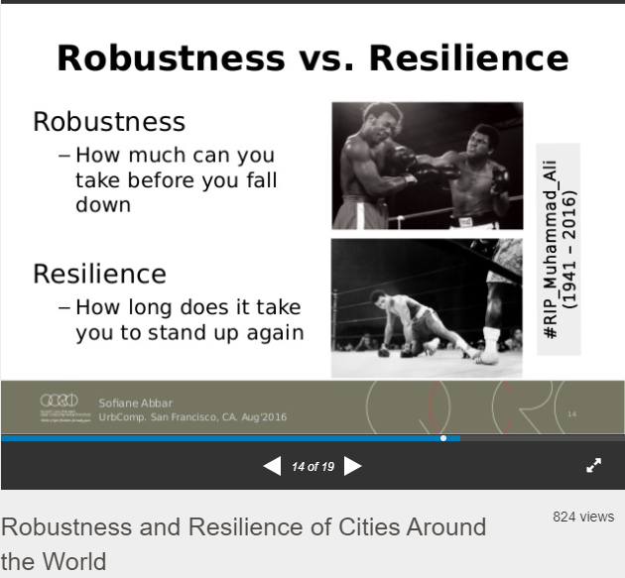
Protecting the data
Automating databases: The basics
Cattle (Infra/Engine) vs Pets (Data)
Resilience trumps robustness
Chaos engineering / Netflix Simian Army
https://www.slideshare.net/vipyoung/robustness-and-resilience-of-cities-around-the-world/14
Notes:
Another way to think about safety in our deployment pipelines is with the resilience vs robustness idea.
Traditionally, relational databases have been designed to be robust. A lot of effort goes into designing RDBMS systems that are hard to kill. However, when they do die, it’s often hard to recover them quickly.
With the idea of resilience vs robustness, we are encouraged to focus more on resilience than robustness. We want to design systems that accept failure as a normal. We should design systems in such a way that they can cope with failures. Our systems need to isolate failures, handle them, and provide as much insight as possible for the humans who are responsible for running them so that the failures can be managed and rectified.

Slide 70
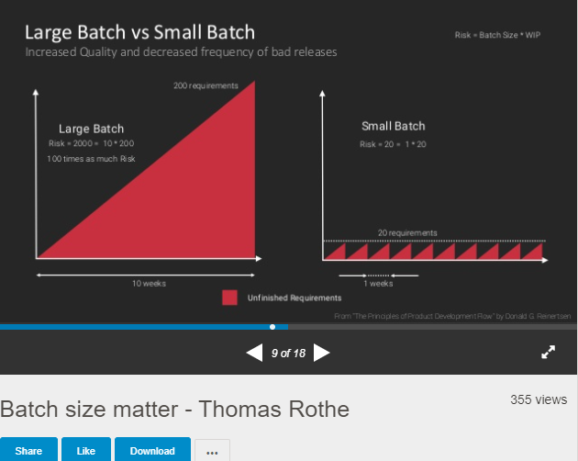
Protecting the data
Automating databases: The basics
Cattle (Infra/Engine) vs Pets (Data)
Resilience trumps robustness
Chaos engineering / Netflix Simian Army
Invest in safe deployment patterns:
Smaller, simpler deployments
https://www.slideshare.net/DevOpsDaysJKT/batch-size-matter-thomas-rothe/9
Notes:
One great way to move away from brittle, robust systems, toward maintainable, resilient systems is to focus on reducing batch sizes as much as possible. 100 tiny deployments are better than 1 massive deployment. Each micro deployment will be much simpler and much more reliable. If it does go wrong, issued are far more likely to be localised, smaller and easier to diagnose and rectify.
In fact, the total number of failed deploys might go up, but the impact of those failures will be significantly reduced, and the general pace of development will increase and lead time will be reduced.

Slide 71
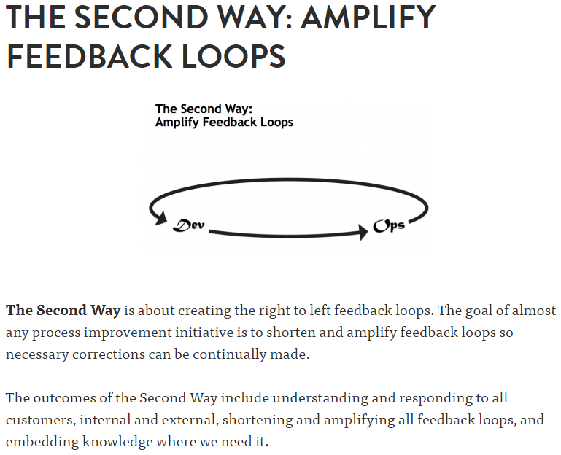
Protecting the data
Automating databases: The basics
Cattle (Infra/Engine) vs Pets (Data)
Resilience trumps robustness
Chaos engineering / Netflix Simian Army
Invest in safe deployment patterns:
Smaller, simpler deployments
Feedback and fix
https://itrevolution.com/the-three-ways-principles-underpinning-devops/
Notes:
What’s more, your team will also get much faster feedback on the stuff they are working on. More timely feedback leads to better code quality and more innovation cycles.

Slide 72
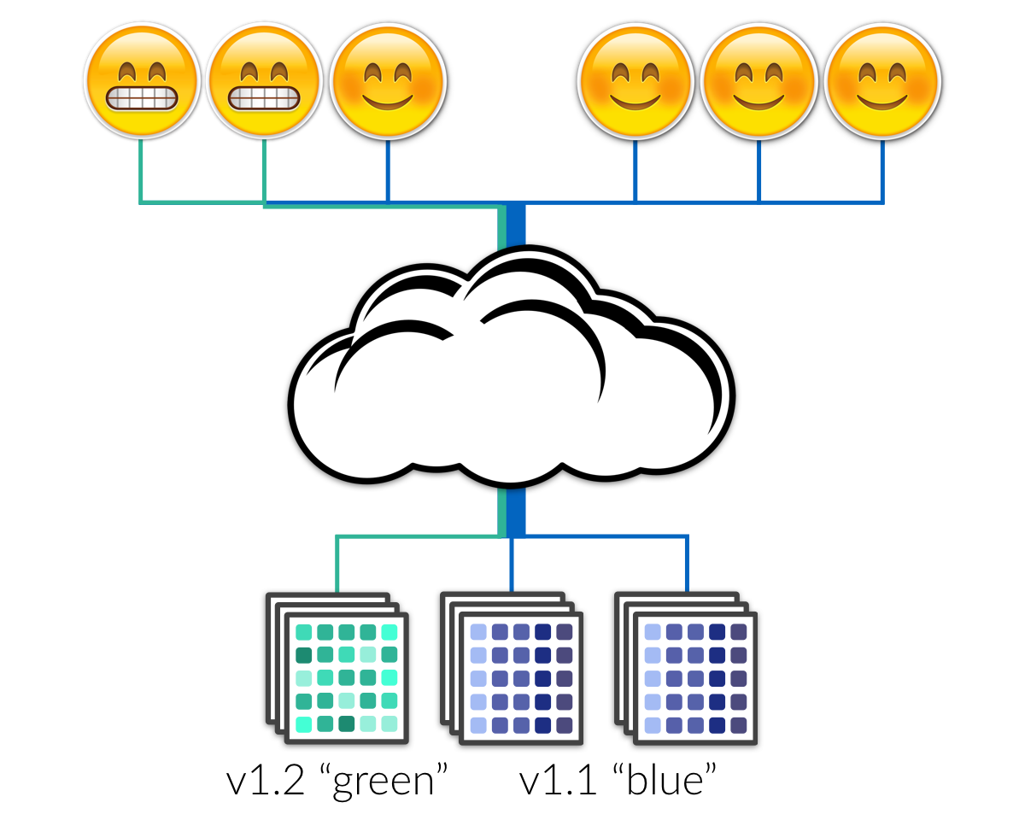
Protecting the data
Automating databases: The basics
Cattle (Infra/Engine) vs Pets (Data)
Resilience trumps robustness
Chaos engineering / Netflix Simian Army
Invest in safe deployment patterns:
Smaller, simpler deployments
Feedback and fix
Patterns that avoid rollbacks
https://blog.turbinelabs.io/deploy-not-equal-release-part-two-acbfe402a91c
Notes:
Of course, frequent releases are only possible if you can decouple your releases from a schedule of infrequent “downtime windows”.
There are various patterns that enable this, such as blue/green deployments, canary releases, dark releases, cluster immune systems etc.
However, all of these clever techniques are only possible if any backend databases can support some level of backward compatibility.

Slide 73
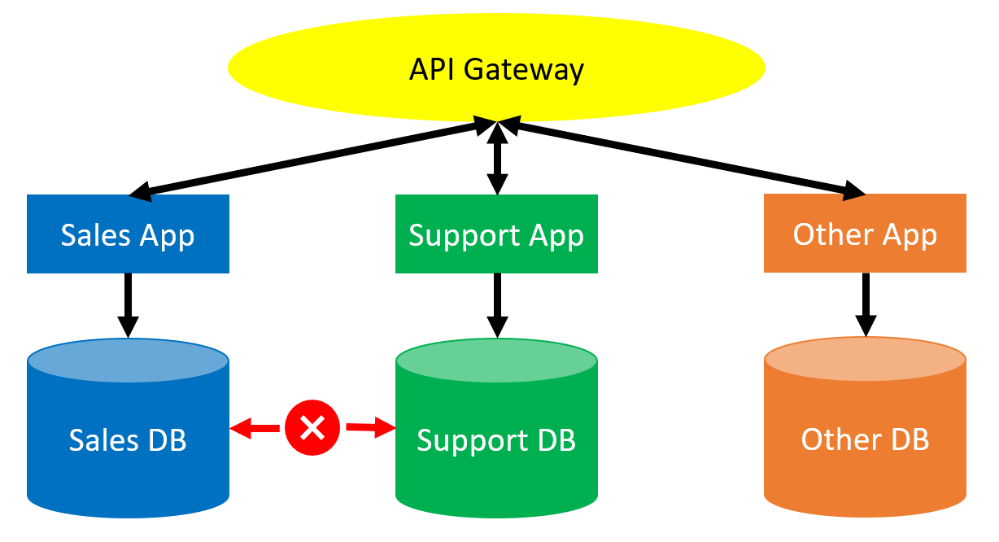
Loose-coupling
Automating databases: The basics
Modular, independent services with a formal communication tier
No direct comms between DBs
Services run independently and are coded defensively to contain failure
Notes:
But designing for safe database releases isn’t just about deployment patterns. Architecture is important too. Big-ball-of-mud monolithic database environments with a million undocumented and poorly understood dependencies are difficult to change safely.
Instead, we should be aiming to break up our monoliths into more loosely coupled modules that can run independently and which use a shared communication tier, probably based on an API. Why? We can test our API calls. And we can code defensively against any dependencies upon any other services.
Note: This means that as a rule we DO NOT write direct DB to DB dependencies using things like sprocs, views or linked servers. These are the things that dependency hell and global failures are made of.
By breaking things down like this, each service can be designed to run independently and to code defensively against any dependencies on other systems. Hence, when the sales system goes offline, the support desk is not effected. While they might lose some visibility to sales data, they should still be able to process core support operations.

Slide 74
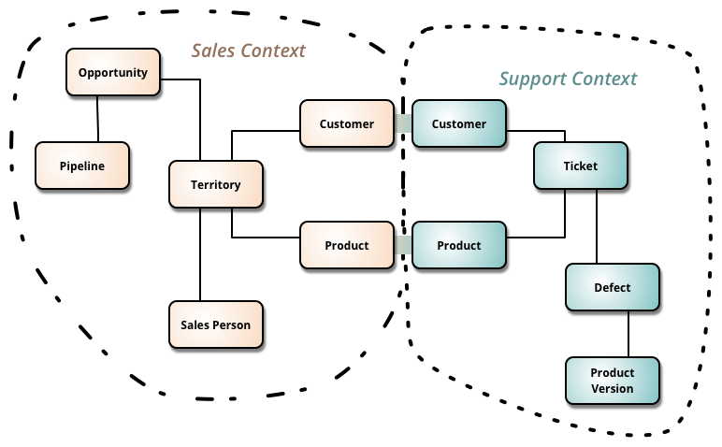
Loose-coupling
Automating databases: The basics
Modular, independent services with a formal communication tier
No direct comms between DBs
Services run independently and are coded defensively
Modules are logically broken down based on Bounded Contexts
https://martinfowler.com/bliki/BoundedContext.html
Notes:
Of course, this comes at a cost. Data processing won’t be as efficient and it can be hard to imagine how one would separate two services that are so tightly entwined. It would probably help to explore the idea of bounded contexts.
Here, we have contexts for support and sales. The teams responsible for each service have drawn out the relationships between the various entities that they care about and have spotted that both sales and support care about products and customers. They have agreed a global view on what a customer and a product should look like and have agreed on various methods to access that data. Aside from these tables, each team can make their own decisions about the implementation of the rest of their services.

Slide 75
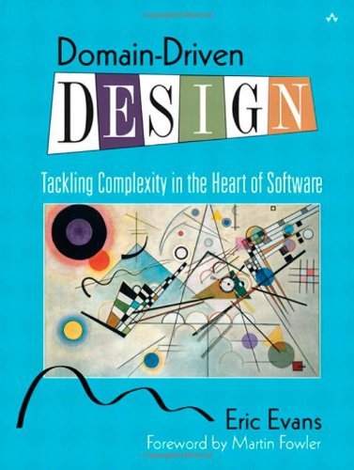
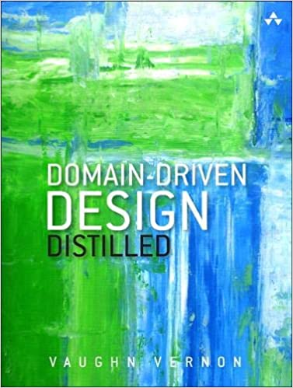
Loose-coupling
Automating databases: The basics
Modular, independent services with a formal communication tier
No direct comms between DBs
Services run independently and are coded defensively
Modules are logically broken down based on Bounded Contexts
Further reading:
Domain-Driven Design, Eric Evans
Domain-Driven Design Distilled, Vaughn Vernon
Notes:
For more information about Domain-Driven Design (DDD) and Bounded Contexts check out these books by Evans and Vaugn. The Evans book is big, thorough and widely regarded as ‘the bible’ for DDD. However, it’s a pretty formidable text. Vaugn’s distilled version is much more accessible. Relatively short and easy to understand, it could be read cover to cover by most developers in an evening or two.

Slide 76
Database DevOps: Database source control and deployment…

Slide 77
Model/State vs Migration
Automating databases: The basics
V1
V2
Notes:
Essentially, here is the challenge: get from one state to another, using some upgrade script.
NEXT SLIDE…

Slide 78
Migrations-based solutions
Automating databases: The basics
V1
V2
Notes:
This leads some to think about database migrations in terms of the upgrade scripts… The source of truth is the upgrade script. Developers write upgrade scripts. They give these scripts to DBAs to review. The scripts get run in a specified order. A simple concept, and one that is easy to automate. It’s the sort of solution that you can hack together in an afternoon or you can use one of the open source frameworks like DbUp or Flyway.
It’s pretty straightforward for users to understand how it all works.
Migrations based solutions consider the journey to be the source of truth.
NEXT SLIDE…

Slide 79
Model-based solutions
Automating databases: The basics
V1
V2
Notes:
Other people still see the value/need to consider the state. This is important for repeatable testing etc.
Migrations become a deployment detail because some would argue that scripting out every minor change is an overhead and opens up possibility of human error.
Model based solutions consider the destination to be the source of truth.
This has the added benefit that it is easier to think declaratively about how specific objects should look. Arguably it is easier to handle source control, branching, merging and CI tasks this way.
NEXT SLIDE…

Slide 80







Model vs migrations
Automating databases: The basics
http://workingwithdevs.com/delivering-databases-migrations-vs-state/
Notes:
So what is better?
Well, this is my attempt to summarise. The answer is neither is perfect.
Generally, if the stuff on the left sounds more like your database, you’ll probably find a state based solution works better for you and visa verca.
However, most people don’t live entirely on one side or the other.
Let’s look at the tools available.

Slide 81


Both work! Model/state-based source control
Automating databases: The basics

Slide 82

Both work! Migrations-based source control
Automating databases: The basics

Slide 83

The problem with models
Automating databases: The basics
Need to understand your tool
It should be obvious if/when tool won’t work
What is the Plan B / override?
Because one day you’ll need it
Test for data loss
Automatically, within process
DROP COLUMN
fullName
ALTER TABLE kittenTrainers
ADD FirstName,
LastName
Notes:
So while the state based approach is arguably better for development and teamwork and for certain types of objects, it could have disastrous consequences when it goes wrong.
It can go wrong when it mistakes a table rename for a drop/create for example. And when using state-based deployment approach, it’s possible the scripts will be different for different environments, for example, if production is at v10 but test is at v13, when you try to deploy v15 to each, you won’t be deploying the exact same script. Hence, you should think carefully about how to test your upgrade scripts. A couple of good approaches include dry run deploys on staging databases and scanning any deploy scripts for key words/phrases, like “DROP TABLE” or “TRUNCATE”. If any are spotted, you could automatically trigger a manual review or warning.
It’s worth highlighting that those manual reviews, and custom deploy scripts per environment, feel counter to conventional DevOps wisdom.
Ultimately, if you are going to employ this approach you need to know the software you are using. (And by the way, you probably need to pay for it. Diff tools are more expensive and there aren’t any open source options. It’s worth investing in a good one for obvious reasons.) You need to be skilled at spotting when it will go wrong. You need to have some sort of review process and a plan B.
Generally, model-based solutions rely on pre/post-deploy scripts to get around these challenges. These work, but they can be a bit confusing to write for various reasons that we don’t have time to go into and they can be a pain to maintain if they aren’t regularly cleaned up. (A common frustration is that after a few years the pre/post-deploy scripts are thousands of lines long with mostly redundant fixes from years-old deployments.)

Slide 84
The problem with migrations
Automating databases: The basics
V2-
branch
v1
Conflicts easily missed
Changes overwritten, hard to spot
Order matters
For views etc, last script wins
The “winding path” problem
What if a bug is deployed to some (but not all) servers?
v2
V4-test
V2.1
v3
v4
V0.6
V...
v28
V...
v149
Notes:
This brings me to the nub of the problem:
With migrations you have to maintain many upgrade scripts.
Strength: Complete control. Power and responsibility.
Weakness: Challenge to manage. Winding path.
So clearly migrations is broken – lets try state…

Slide 85
So which is better for you?
Automating databases: The basics
Model (cleverer)
Easier (less control)
Better for sprocs/functions
Better for large teams
Better for frequent changes
Better at dependencies
Drift: rolled back
Simpler for dev work
Migrations (simpler)
More control (needs discipline)
Better for data migrations
Better for small teams
Better for infrequent changes
Better for simple data stores
Drift: ignored
Simpler for automation
Notes:
So what is better?
Well, this is my attempt to summarise. The answer is neither is perfect.
SSDT/Redgate etc do a lot of the hard work for you. They extrapolate away a lot of the complexity. Assuming it all works, that’s great. When it doesn’t work, you’d probably be better off with a migrations solution
Stateless objects, such as sprocs are much easier to manage declaratively. However, it’s more intuitive to think about stateful objects (like tables) in terms of migrations.
Since models are much better at merging and handling multiple threads of work, this generally makes models better for larger dev teams.
Since migrations are far more painful when there are many scripts to manage, they are particularly problematic for databases with a high number of changes
The smarts that come with model-based systems generally take a lot of the pain out of dependency management. Hence, they can be useful for monoliths. (Caveat: If your monolith is really bad, the software might be slow or unable to handle it. That might force you back to migrations.)
It’s important to understand the consequences of drift.
Fundamentally, models seem to be optimised for making development easier, and migrations is optimised for solving deployment automation. Unfortunately, you want both. Ultimately, it’s a trade-off.
Generally, if the stuff on the left sounds more like your database, you’ll probably find a model-based solution works better for you and visa verca.
However, most people don’t live entirely on one side or the other.
Let’s look at the tools available.

Slide 86

Expand/contract
Automating databases: The basics
Deploy != Release
Support backward compatibility
Test in production
Rollback releases without database changes!
Zero downtime
Significantly lower risk
Don’t forget to clean up!
https://www.slideshare.net/leenasn/expand-contract-pattern-continuous-delivery-and-databases/22
Notes:
These leads us to possibly the most important pattern for database releases: Expand contract. Also known as evolutionary database design.
This development model is really key to making significant gains with respect to database delivery performance. One of the key practices that’s required to achieve it is automated deployments from source control. That’s because if the overhead associated with releases in high, it encourages the batching up of releases to “save effort”, which leads to those bigger, more complicated, and less frequent releases which cause more harm than good in the long run.
And there are a couple of ways to source control and automate database releases…
NEXT SLIDE

Slide 87
Agenda
PART 1 – INTROS
09:00 - Welcome
09:30 - A brief intro to DevOps
10:00 - Forking the repo
PART 3 – DEPLOYING DATABASES
13:00 - Database DevOps
13:30 - Exploring the tooling options
14:00 - Configuring an SSDT project
10:30 Morning break
PART 2 – DEPLOYING INFRASTUCTURE
11:00 - Using Octopus Runbooks to
manage infrastructure
12:00 Lunch
14:45 Afternoon Break
PART 4 – EXTENSIONS
15:15 - Redgate, DbUp, Entity Framework
16:30 - Q+A
17:00 End of day
Notes:
Now we’re all acquainted, let’s explore the agenda for the day.
Briefly talk through the agenda.
Key points:
Break times: Do these work for everyone?
Prerequisites: You should have completed the prerequisites and lab 1 in advance. But don’t worry if you haven’t. There aren’t any new labs before the 1st break. If anyone still need to create their accounts or complete lab 1 please do so during the 1st break. Also if anyone had any issues please send me a message and we can pick it up in the break.
We’ll start with a basic DevOps 101 crash course. Before we write any code, let’s make sure we understand why we are doing this at all and why it’s important/valuable.
Part 2 is all about the infrastructure. Deploying our infrastructure and using Source Control, PowerShell and Octopus Runbooks to automate and audit our SQL Server installations.
Part 3 is mainly theoretical. I’ll talk about the various different approaches to database source control and deployment and I’ll provide an overview of the most popular tools.
In part 4 we’ll create our first database deployment pipeline using SSDT, since it’s the most popular tool for SQL Server.
Finally, in part 5, we’ll look at some alternate database deployment pipelines and you’ll have the opportunity to try out whichever tools you are most intrigued by.
We’ll aim to finish our PoCs by 4.30 to allow us 30 minutes for general Q+A and conversation, before finishing at 5pm. However, if we don’t finish on time you own all the code, infra and training materials so you can continue to build and extend your PoC in your own time at your own convenience and we’ll be happy to help over email etc for the next week to ensure you complete your PoC.

Slide 88
Our tooling options
Exploring the tooling options
SSDT (Microsoft, the de facto standard)
Redgate (The premier 3rd party solution)
DbUp (A popular OS project by Paul Stovel, Octopus CEO)
Entity Framework Migrations (The most popular MSSQL ORM)
Notes:
In this class we’ll look at a few options.
SSDT: The most popular tool. It’s free, and advocated by Microsoft themselves.
Redgate: The most popular 3rd party tooling and considered the premier solution by many. Also, probably, the most widely used tool after SSDT.
DbUp: A migration runner written by Paul Stovell. Very popular and used by Octopus Deploy themselves to deploy the Octopus Deploy backend SQL Server database for on-prem Octopus Deploy setups.
EF Migrations: Popular with web developers. Entity Framework is the most popular ORM for SQL server.

Slide 89

What do people actually use?
Exploring the tooling options
https://octopus.com/blog/sql-server-deployment-options-for-octopus-deploy
Notes:
This data has been pulled from Octopus Deploy feature usage stats.
As you can see, SSDT is the most popular step template, followed by Redgate, and then Entity Framework migrations.
Flyway get’s a moderate amount of usage but it’s hard to say which is the most popular migration runner since it’s unclear how many folks use the community step templates. DbUp, for example, doesn’t have a Community Step template, since for various technical details, it wouldn’t actually make a lot of sense to create a special step template for a DbUp deployment.
That said, since DbUp is generally fairly popular for SQL Server deployments, and since it was written by Paul, we’ll take a look at DbUp later.

Slide 90






Exploring the tooling options
Exploring the tooling options
Model
Model
Or
Migrations?
Migrations
SSMS
AND
budget
SSMS
AND budget
or
VS OR
no budget?
VS/ADS
OR
no budget
Commercial
hybrid
Commercial
hybrid or pure OSS
migrations?
OSS migrations

Slide 91

More info re. Redgate vs SSDT
https://www.brentozar.com/archive/2018/12/comparison-review-microsoft-ssdt-vs-red-gate-sql-source-control/

Slide 92
Agenda
PART 1 – INTROS
09:00 - Welcome
09:30 - A brief intro to DevOps
10:00 - Forking the repo
PART 3 – DEPLOYING DATABASES
13:00 - Database DevOps
13:30 - Exploring the tooling options
14:00 - Configuring an SSDT project
10:30 Morning break
PART 2 – DEPLOYING INFRASTUCTURE
11:00 - Using Octopus Runbooks to
manage infrastructure
12:00 Lunch
14:45 Afternoon Break
PART 4 – EXTENSIONS
15:15 - Redgate, DbUp, Entity Framework
16:30 - Q+A
17:00 End of day
Notes:
Now we’re all acquainted, let’s explore the agenda for the day.
Briefly talk through the agenda.
Key points:
Break times: Do these work for everyone?
Prerequisites: You should have completed the prerequisites and lab 1 in advance. But don’t worry if you haven’t. There aren’t any new labs before the 1st break. If anyone still need to create their accounts or complete lab 1 please do so during the 1st break. Also if anyone had any issues please send me a message and we can pick it up in the break.
We’ll start with a basic DevOps 101 crash course. Before we write any code, let’s make sure we understand why we are doing this at all and why it’s important/valuable.
Part 2 is all about the infrastructure. Deploying our infrastructure and using Source Control, PowerShell and Octopus Runbooks to automate and audit our SQL Server installations.
Part 3 is mainly theoretical. I’ll talk about the various different approaches to database source control and deployment and I’ll provide an overview of the most popular tools.
In part 4 we’ll create our first database deployment pipeline using SSDT, since it’s the most popular tool for SQL Server.
Finally, in part 5, we’ll look at some alternate database deployment pipelines and you’ll have the opportunity to try out whichever tools you are most intrigued by.
We’ll aim to finish our PoCs by 4.30 to allow us 30 minutes for general Q+A and conversation, before finishing at 5pm. However, if we don’t finish on time you own all the code, infra and training materials so you can continue to build and extend your PoC in your own time at your own convenience and we’ll be happy to help over email etc for the next week to ensure you complete your PoC.

Slide 93
LAB 8.1: Defining a SQL Server Deployment Process (SSDT)
Configuring an SSDT project
Tasks:
Create a “Package / Deploy a Package” step
Create a “SQL – Deploy a DACPAC” step (Community Step Template)
Notes:
Configure the project

Slide 94

LAB 9: Deploying your database(s)
Configuring an SSDT project
Tasks:
Create a new release
Deploy the release
Notes:
Create a release and deploy it.
Did it work?

Slide 95

Coffee break: Re-starting at 15:15 Want to learn more? Check out the additional reading for each of the labs!
Notes:
Image source: https://libreshot.com/coffee-beans-2/
Image licence: https://libreshot.com/license-information/
During the break, if the presenter does not yet have a “here’s one I made earlier” pipeline using Redgate, DbUp and Entity Framework, now is the time to produce it.

Slide 96
Agenda
PART 1 – INTROS
09:00 - Welcome
09:30 - A brief intro to DevOps
10:00 - Forking the repo
PART 3 – DEPLOYING DATABASES
13:00 - Database DevOps
13:30 - Exploring the tooling options
14:00 - Configuring an SSDT project
10:30 Morning break
PART 2 – DEPLOYING INFRASTUCTURE
11:00 - Using Octopus Runbooks to
manage infrastructure
12:00 Lunch
14:45 Afternoon Break
PART 4 – EXTENSIONS
15:15 - Redgate, DbUp, Entity Framework
16:30 - Q+A
17:00 End of day
Notes:
Now we’re all acquainted, let’s explore the agenda for the day.
Briefly talk through the agenda.
Key points:
Break times: Do these work for everyone?
Prerequisites: You should have completed the prerequisites and lab 1 in advance. But don’t worry if you haven’t. There aren’t any new labs before the 1st break. If anyone still need to create their accounts or complete lab 1 please do so during the 1st break. Also if anyone had any issues please send me a message and we can pick it up in the break.
We’ll start with a basic DevOps 101 crash course. Before we write any code, let’s make sure we understand why we are doing this at all and why it’s important/valuable.
Part 2 is all about the infrastructure. Deploying our infrastructure and using Source Control, PowerShell and Octopus Runbooks to automate and audit our SQL Server installations.
Part 3 is mainly theoretical. I’ll talk about the various different approaches to database source control and deployment and I’ll provide an overview of the most popular tools.
In part 4 we’ll create our first database deployment pipeline using SSDT, since it’s the most popular tool for SQL Server.
Finally, in part 5, we’ll look at some alternate database deployment pipelines and you’ll have the opportunity to try out whichever tools you are most intrigued by.
We’ll aim to finish our PoCs by 4.30 to allow us 30 minutes for general Q+A and conversation, before finishing at 5pm. However, if we don’t finish on time you own all the code, infra and training materials so you can continue to build and extend your PoC in your own time at your own convenience and we’ll be happy to help over email etc for the next week to ensure you complete your PoC.

Slide 97
LAB 8.2: Creating a Redgate deployment project
Redgate, DbUp, Entity Framework
Create a “”Package / Deploy a Package” step to deploy the SqlServerCentral Package.
Create a “Redgate – Deploy from Package” step (Community Step Template)
Provide the following details:
On Targets in Roles: my_sql_octopus_poc-DbJumpbox
Database package step: (Your “Package / Deploy a Package” step)
Target SQL Server Instance: #{SQLSERVER_IP}
Target database name: SqlServerCentral
Username: octopus
Password: #{OCTOPUS_SQL_PASSWORD}
Trust Server Certificate: True
Notes:
Presenter walks through their “here’s one I made earlier” Redgate deployment process. DO NOT ask attendees to complete this lab.

Slide 98
LAB 8.3: Creating a DbUp deployment project
Redgate, DbUp, Entity Framework
TO DO!
DEMO ONLY
Notes:
Presenter walks through their “here’s one I made earlier” DbUp deployment process. DO NOT ask attendees to complete this lab.

Slide 99
LAB 8.4: Creating an Entity Framework deployment project
Redgate, DbUp, Entity Framework
TO DO!
DEMO ONLY
Notes:
Presenter walks through their “here’s one I made earlier” EF deployment process. DO NOT ask attendees to complete this lab.

Slide 100
LAB 8.x: Choose your own tooling!
Redgate, DbUp, Entity Framework
Now take your pick out of Redgate, DbUp and Entity Framework and build you own alternate deployment pipeline(s).
TO DO!
(Screenshot of Deploy Process with all the steps for all the databases.)

Slide 101
Agenda
PART 1 – INTROS
09:00 - Welcome
09:30 - A brief intro to DevOps
10:00 - Forking the repo
PART 3 – DEPLOYING DATABASES
13:00 - Database DevOps
13:30 - Exploring the tooling options
14:00 - Configuring an SSDT project
10:30 Morning break
PART 2 – DEPLOYING INFRASTUCTURE
11:00 - Using Octopus Runbooks to
manage infrastructure
12:00 Lunch
14:45 Afternoon Break
PART 4 – EXTENSIONS
15:15 - Redgate, DbUp, Entity Framework
16:30 - Q+A
17:00 End of day
Notes:
Now we’re all acquainted, let’s explore the agenda for the day.
Briefly talk through the agenda.
Key points:
Break times: Do these work for everyone?
Prerequisites: You should have completed the prerequisites and lab 1 in advance. But don’t worry if you haven’t. There aren’t any new labs before the 1st break. If anyone still need to create their accounts or complete lab 1 please do so during the 1st break. Also if anyone had any issues please send me a message and we can pick it up in the break.
We’ll start with a basic DevOps 101 crash course. Before we write any code, let’s make sure we understand why we are doing this at all and why it’s important/valuable.
Part 2 is all about the infrastructure. Deploying our infrastructure and using Source Control, PowerShell and Octopus Runbooks to automate and audit our SQL Server installations.
Part 3 is mainly theoretical. I’ll talk about the various different approaches to database source control and deployment and I’ll provide an overview of the most popular tools.
In part 4 we’ll create our first database deployment pipeline using SSDT, since it’s the most popular tool for SQL Server.
Finally, in part 5, we’ll look at some alternate database deployment pipelines and you’ll have the opportunity to try out whichever tools you are most intrigued by.
We’ll aim to finish our PoCs by 4.30 to allow us 30 minutes for general Q+A and conversation, before finishing at 5pm. However, if we don’t finish on time you own all the code, infra and training materials so you can continue to build and extend your PoC in your own time at your own convenience and we’ll be happy to help over email etc for the next week to ensure you complete your PoC.

Slide 102
Q+A
Q+A
?
Notes:
This time is unstructured.
If you have been running late, this is your 30 minutes of buffer space. Hopefully this will help you to finish on time.
If you are running on schedule, this is an opportunity for attendees to ask questions and discuss options.
“Attendees: consider this your 30 minutes of free consultancy!”

Slide 103
Agenda
PART 1 – INTROS
09:00 - Welcome
09:30 - A brief intro to DevOps
10:00 - Forking the repo
PART 3 – DEPLOYING DATABASES
13:00 - Database DevOps
13:30 - Exploring the tooling options
14:00 - Configuring an SSDT project
10:30 Morning break
PART 2 – DEPLOYING INFRASTUCTURE
11:00 - Using Octopus Runbooks to
manage infrastructure
12:00 Lunch
14:45 Afternoon Break
PART 4 – EXTENSIONS
15:15 - Redgate, DbUp, Entity Framework
16:30 - Q+A
17:00 End of day
Notes:
Now we’re all acquainted, let’s explore the agenda for the day.
Briefly talk through the agenda.
Key points:
Break times: Do these work for everyone?
Prerequisites: You should have completed the prerequisites and lab 1 in advance. But don’t worry if you haven’t. There aren’t any new labs before the 1st break. If anyone still need to create their accounts or complete lab 1 please do so during the 1st break. Also if anyone had any issues please send me a message and we can pick it up in the break.
We’ll start with a basic DevOps 101 crash course. Before we write any code, let’s make sure we understand why we are doing this at all and why it’s important/valuable.
Part 2 is all about the infrastructure. Deploying our infrastructure and using Source Control, PowerShell and Octopus Runbooks to automate and audit our SQL Server installations.
Part 3 is mainly theoretical. I’ll talk about the various different approaches to database source control and deployment and I’ll provide an overview of the most popular tools.
In part 4 we’ll create our first database deployment pipeline using SSDT, since it’s the most popular tool for SQL Server.
Finally, in part 5, we’ll look at some alternate database deployment pipelines and you’ll have the opportunity to try out whichever tools you are most intrigued by.
We’ll aim to finish our PoCs by 4.30 to allow us 30 minutes for general Q+A and conversation, before finishing at 5pm. However, if we don’t finish on time you own all the code, infra and training materials so you can continue to build and extend your PoC in your own time at your own convenience and we’ll be happy to help over email etc for the next week to ensure you complete your PoC.

Slide 104
Additional resources
End of day
Some resources
Where attendees
Can learn more
About the topics
In this class
TO DO!
Notes:
You can learn more using these additional resources.

Slide 105
IMPORTANT: What you are currently paying for!
End of day
Instances: <$0.02/hr
Secrets: $0.40/month
To stop paying, you must do one of the following:
Delete all secrets and instances (in all regions) in the AWS console.
Create a new runbook for hard_reset-kill_everything.ps1 (no parameters required).
See the appendices in the lab manual for details.
Notes:
If you have not already done it, we recommend that you set yourself a reminder to remove all AWS stuff. (Especially expensive stuff: instances/secrets)
Recommend the use of cost/usage budgets in AWS:
https://aws.amazon.com/getting-started/hands-on/control-your-costs-free-tier-budgets/

Slide 106
A reminder: Why we are here
End of day
Automated deployments are simultaneously:
Faster
Safer
Cheaper
Active learning beats passive learning:
Build your own PoC
Keep your own personal reference project
Notes:
Why are we here?
We understand that automated deployments enable a virtuous cycle of speed and safety, that’s fundamentally better suited to releasing working software, on time, and under budget.
In order to develop the knowledge and skills to practice automated deployments, we are going to embrace active learning. We aren’t just going to talk, we are going to get our hands dirty. And when we are done, you’ll have your own template solution that you can spin up and tear down whenever you like. You’ll leave today with a reference project in your back pocket, which you can use as a template as you roll our these tools within your own organisations.

Slide 107
A reminder: Today’s learning objective
Welcome
Attendees will understand, and have practical experience using, the core Octopus features and additional tools/services required to automate database deployments, including:
Environments, Deployment Targets, Tentacles and Workers
Operations Runbooks, Deployments, Variables and Releases
Various open-source and 3rd party database deployment tooling options
Attendees will have an awareness of more advanced Octopus features, and an opportunity to discuss unique requirements with an experienced trainer.
Additionally, attendees will learn the bare minimum GitHub and AWS skills required to implement a SQL Server deployment pipeline.
Notes:
You are going to build and deploy your own website to the public internet – end to end.
If you don’t have any experience with GitHub, AWS

Slide 108
A reminder: Today’s task
End of day
Build your own working PoC by the end of the day.
You’ll deploy a
SQL Server Database (from…)
GitHub (onto…)
Windows Servers (hosted in…)
Amazon Web Services (AWS)
(Other tech/platforms are available)
Notes:
You are going to build and deploy your own website to the public internet – end to end.
If you don’t have any experience with GitHub, AWS

Slide 109
A reminder: Octopus Deploy (vs Competition / Octo USP)
End of day
Some
Intro
To
Octopus
TO DO!
Do the folks at Octopus already have a sliced for this?
Notes:
First, let’s introduce Octopus. You might know a little or a lot about us already, but here’s an overview of what we are about, why we exist, and what we do.

Slide 110
More classes in this series
End of day
Deploying SQL Server databases
Managing Infrastructure with Terraform and Octopus
Deploying to Kubernetes
Chaos Engineering deep dive
Advanced, zero downtime deployment patterns
Hardening Octopus security deep dive
(Just ideas!)
PLACEHOLDER SLIDE (Update before class)
Notes:
This slide is just an example

Slide 111
Upcoming class schedule
End of day
1st of Whentember: Deploying SQL Server Databases
32nd of Futurary: Chaos Engineering Deep Dive
Reserve your place: www.someURL.com
Book a private class: www.anotherURL.com
PLACEHOLDER SLIDE (Update before class)
Notes:
This slide is just an example

Slide 112
Your trainer (Custom slide to be completed by trainer)
End of day
Contact me: my.email@address.com
Additional training/consulting services:
DevOps masterclass
DevOps Health Check
More details: www.mywebsite.com
Feedback: www.feedbackURL.com
PLACEHOLDER SLIDE (Update before class)
Notes:
To be filled in by the trainer. This is their opportunity to pitch their own consulting/training services.

Slide 113
Happy Deployments!
End of day
INSERT APPROPRIATE INSPIRING IMAGE
TO DO!

Slide 114
Testimonial
“The hands on experience is great, I was able to follow with no problem even with zero prior experience in Octopus and AWS (limited github experience). I feel basic prior automation and/or DevOps knowledge might be beneficial - especially about packaging.
I like how it was tailored for DB specialists which are often a forgotten group.
DevOps and automation are often interchangeable, but this workshop put things in context.”
Tomáš Zíka
Database Specialist at Alza.cz a.s.

